Slide 1
Participant Logo

Slide 2

Integrating Large Language Models into the in-silico environmental assessment of new chemicals and materials for SSbD
Gustavo Larrea-Gallegos ¹, Antonino Marvuglia¹
1 Luxembourg Institute of Science and Technology

Slide 3
Agenda
Introduction
Research goal
Methodology
Functioning
Takeaways

Slide 4
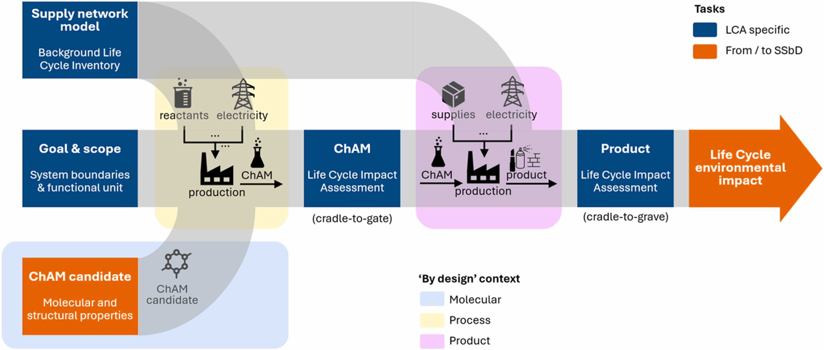
By design in SSbD

Slide 5
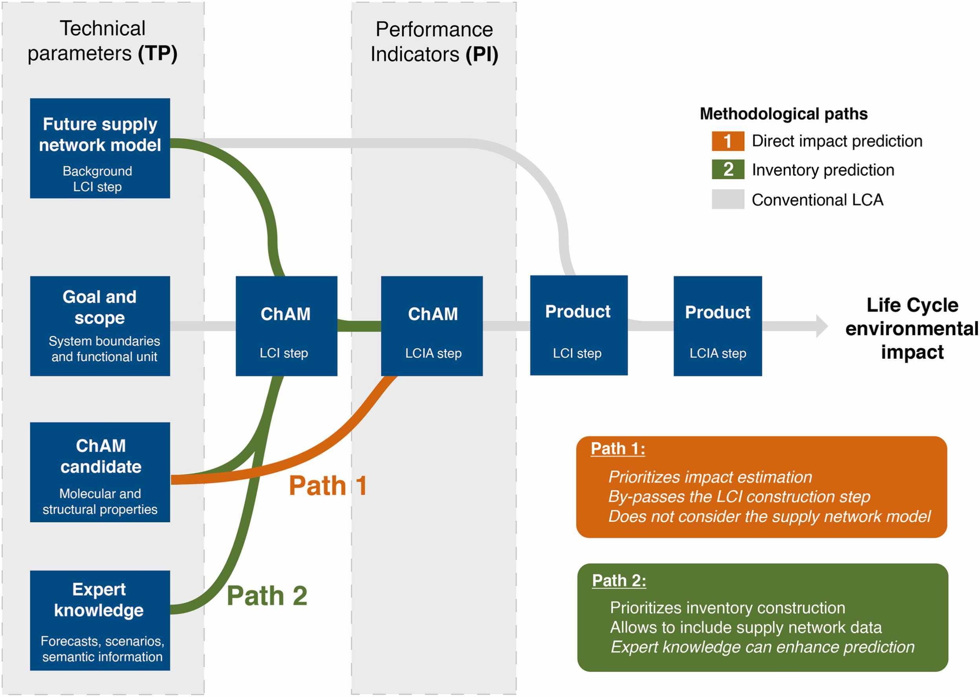
Path 1 and Path 2
> LCI modeling is iterative by nature
> Data gathering can be costly

Slide 6
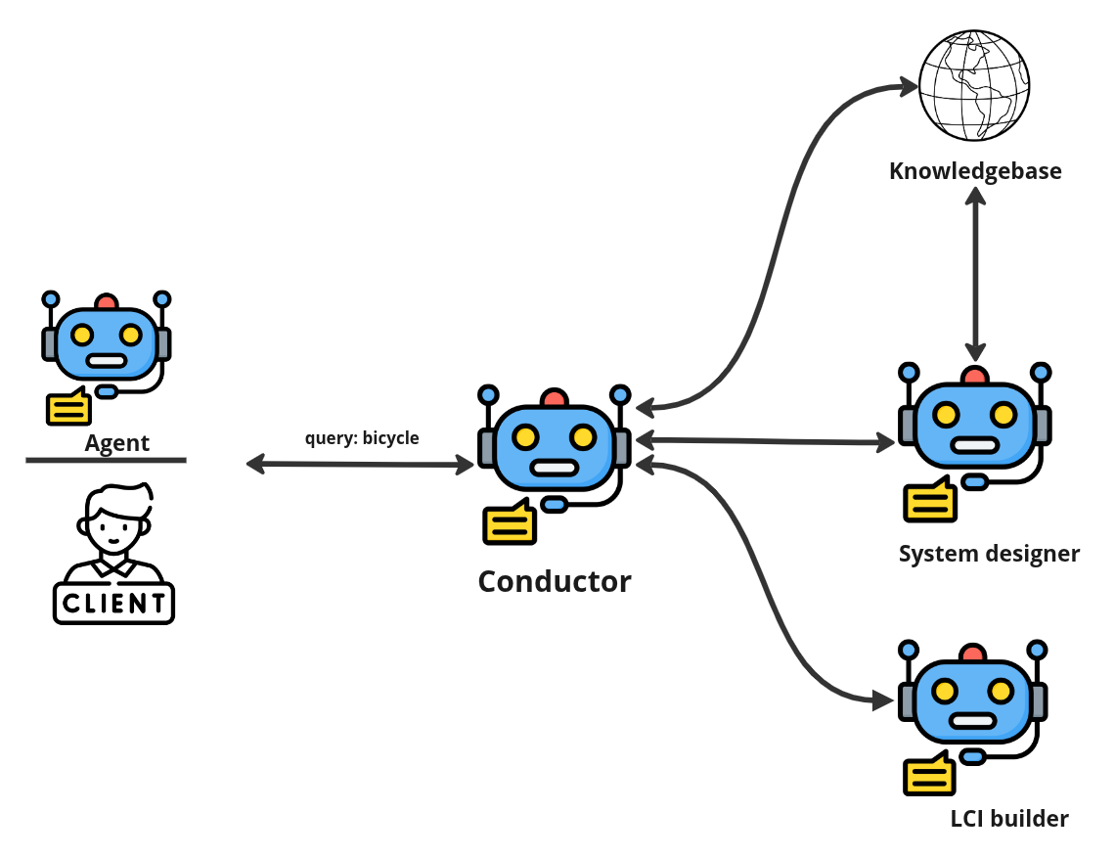
An agentic system for LCI modeling
> Tasks are distributed among agents (resource efficiency)
> Agents have goals and tools.

Slide 7
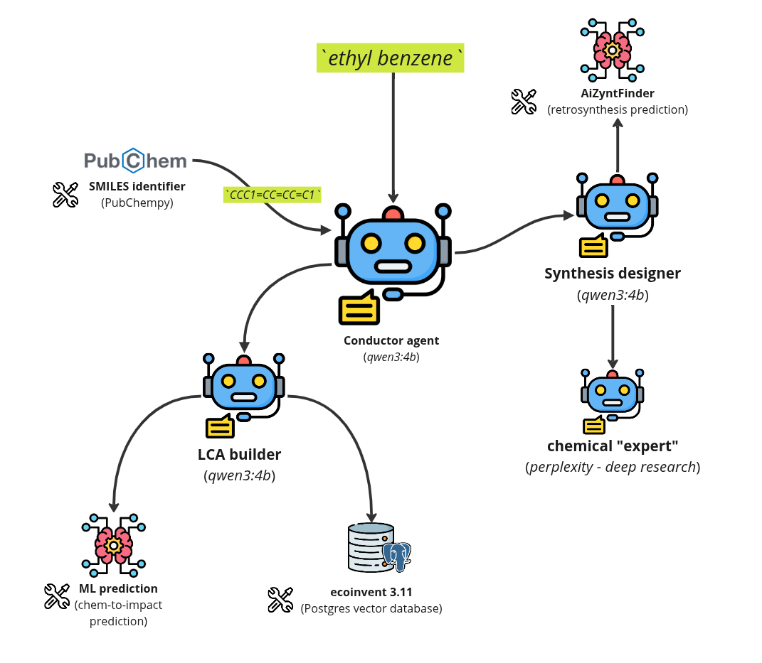
A system for drafting LCI datasets
> LCI is explicitly built from user query.
> Tasks are distributed among agents (resource efficiency)
> Agents have goals and tools.

Slide 8
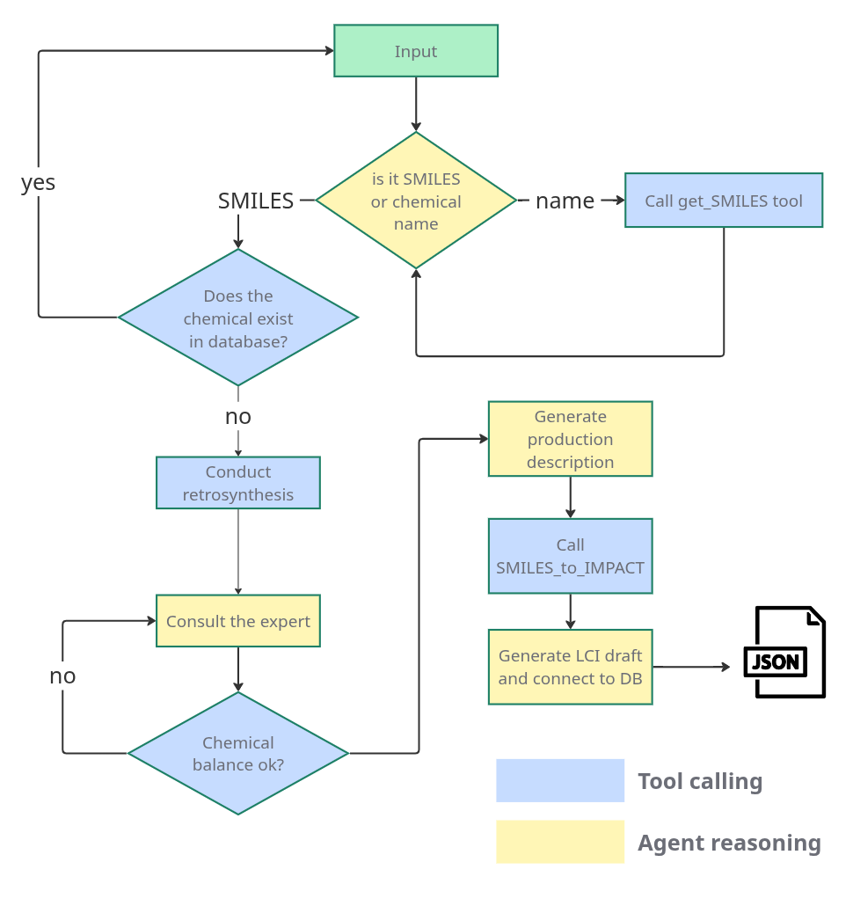
Conductor agent
> The conductor has a sequence of steps to follow.
> The conductor prepares the inputs and outputs when using tools.

Slide 9
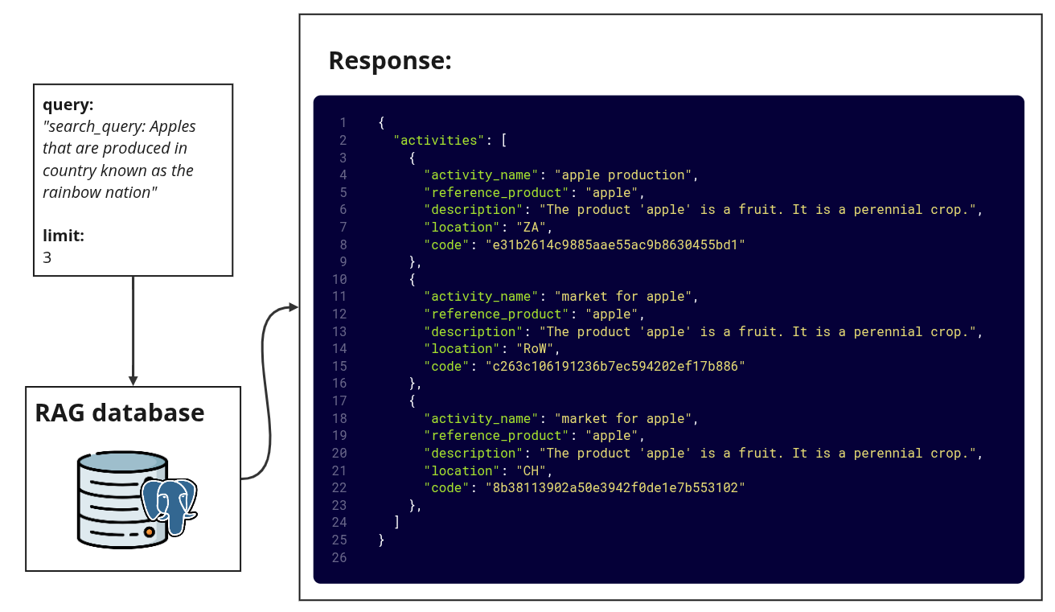
RAG system
The activity named market for sawnwood ... produces 1 cubic meter of sawnwood ... The product 'sawnwood ... represents … This activity representative of the location: CH. Some synonyms of this product are [...].
[0.20, 0.13, … , 0.65, 1.2]

Slide 10
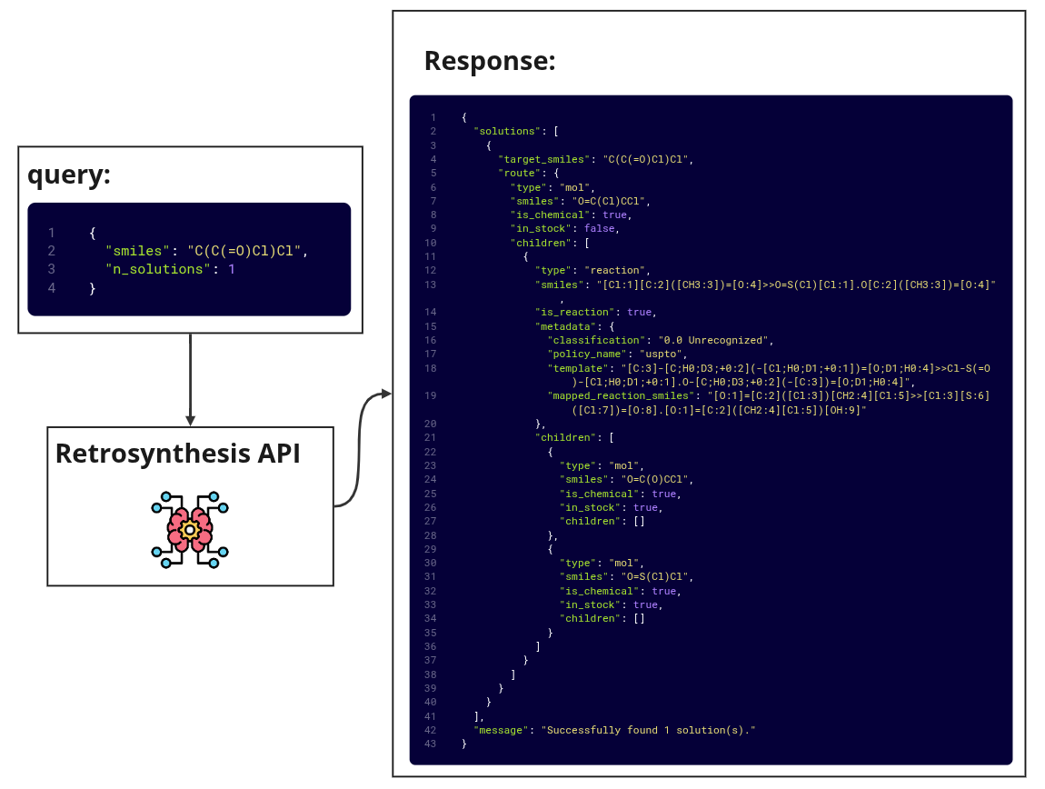
Retrosynthesis tool
> Uses Monte Carlo Tree search
> Breaks down the molecule into purchase precursors

Slide 11
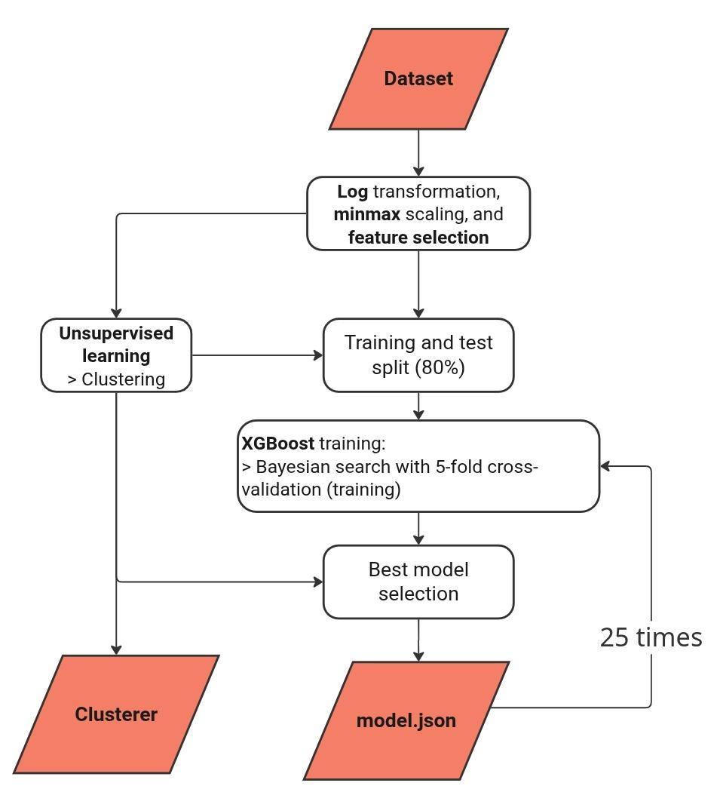
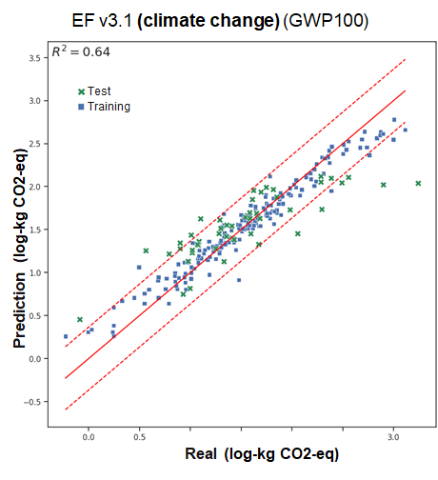
SMILE to impact tool
> XGboost model trained with ecoinvent data
> Uses descriptors obtained from PaDEL tool.

Slide 12
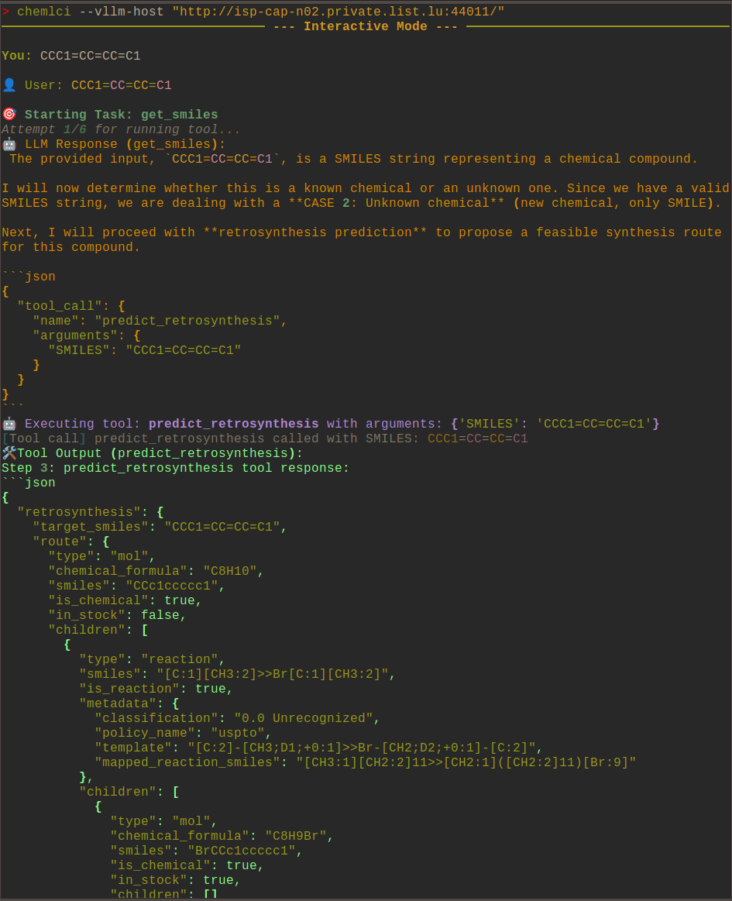
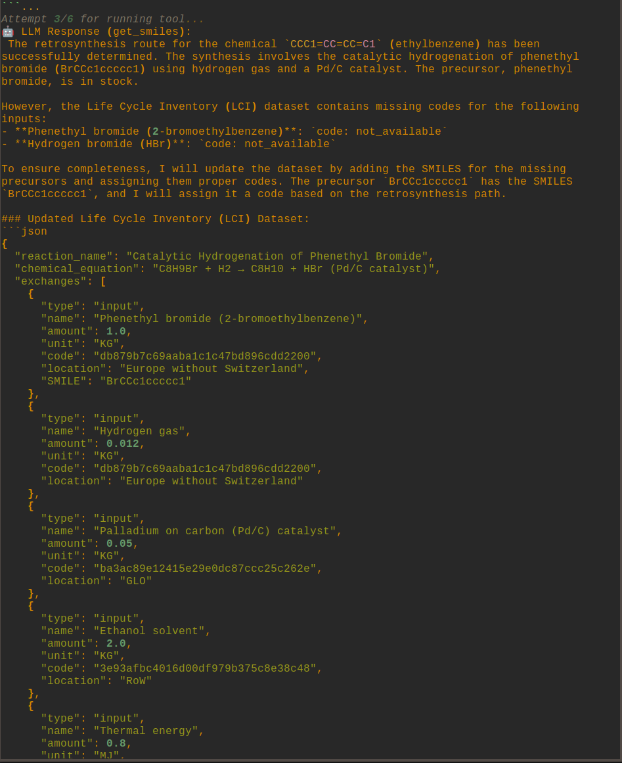
Agent functioning

Slide 13
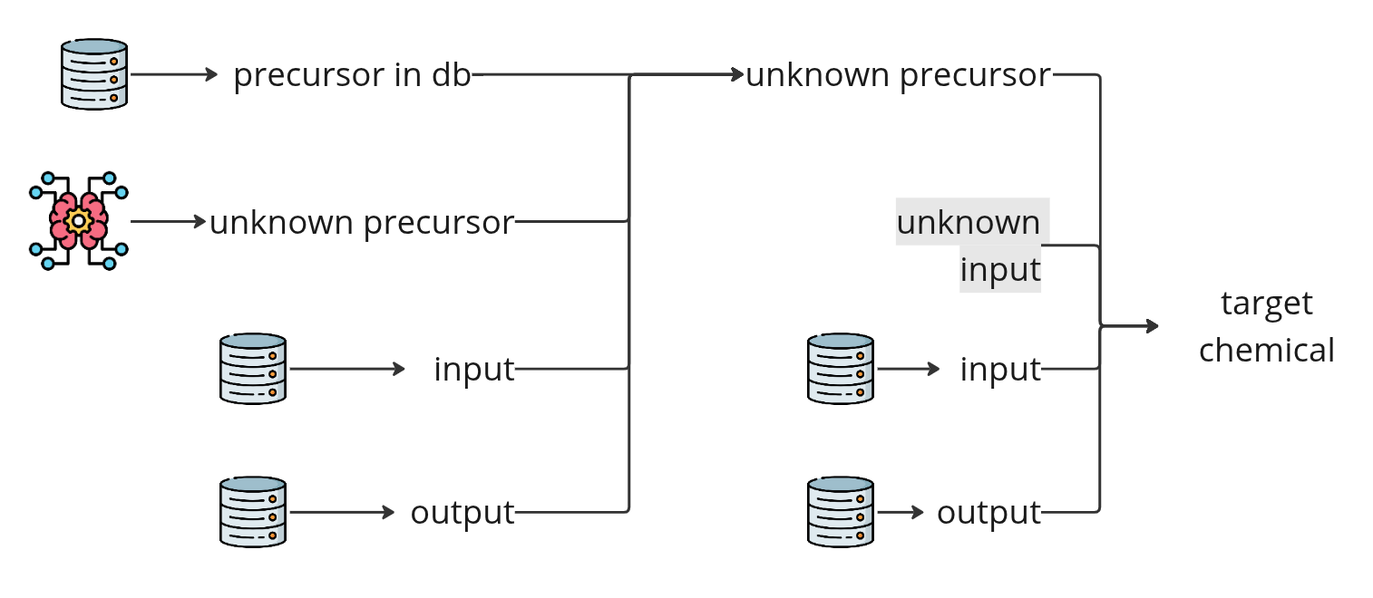
Inventory draft
> Unknown precursors’ impacts are aggregated in the LCIA stage
> Unknown precursors’ impacts are aggregated in the LCIA stage

Slide 14
Limitations and following steps
> Defining an expert agent with decision heuristics is far from trivial, meaning that validation tools are needed
> The “expert” knowledge base is limited to public papers, US patents and internet. A curated knowledge is needed.
> An adequate validation strategy is needed for inventories from know routes (i.e., patents and articles), and from complete new ones.

Slide 15
Final remarks
> The agentic system can following instructions and generate LCI drafts from simple queries.
> LLMs could help in the automation of repetitive tasks, however some heavy lifting still relies on regression modules.
> Agentic approaches can help to increase the space of chemicals that can be simultaneously explored or modeled in the innovation phase

Slide 16

gustavo.larrea@list.lu
PINK has received funding from the European Union’s Horizon Europe Research and Innovation programme under grant agreement No. 101137809

Slide 17
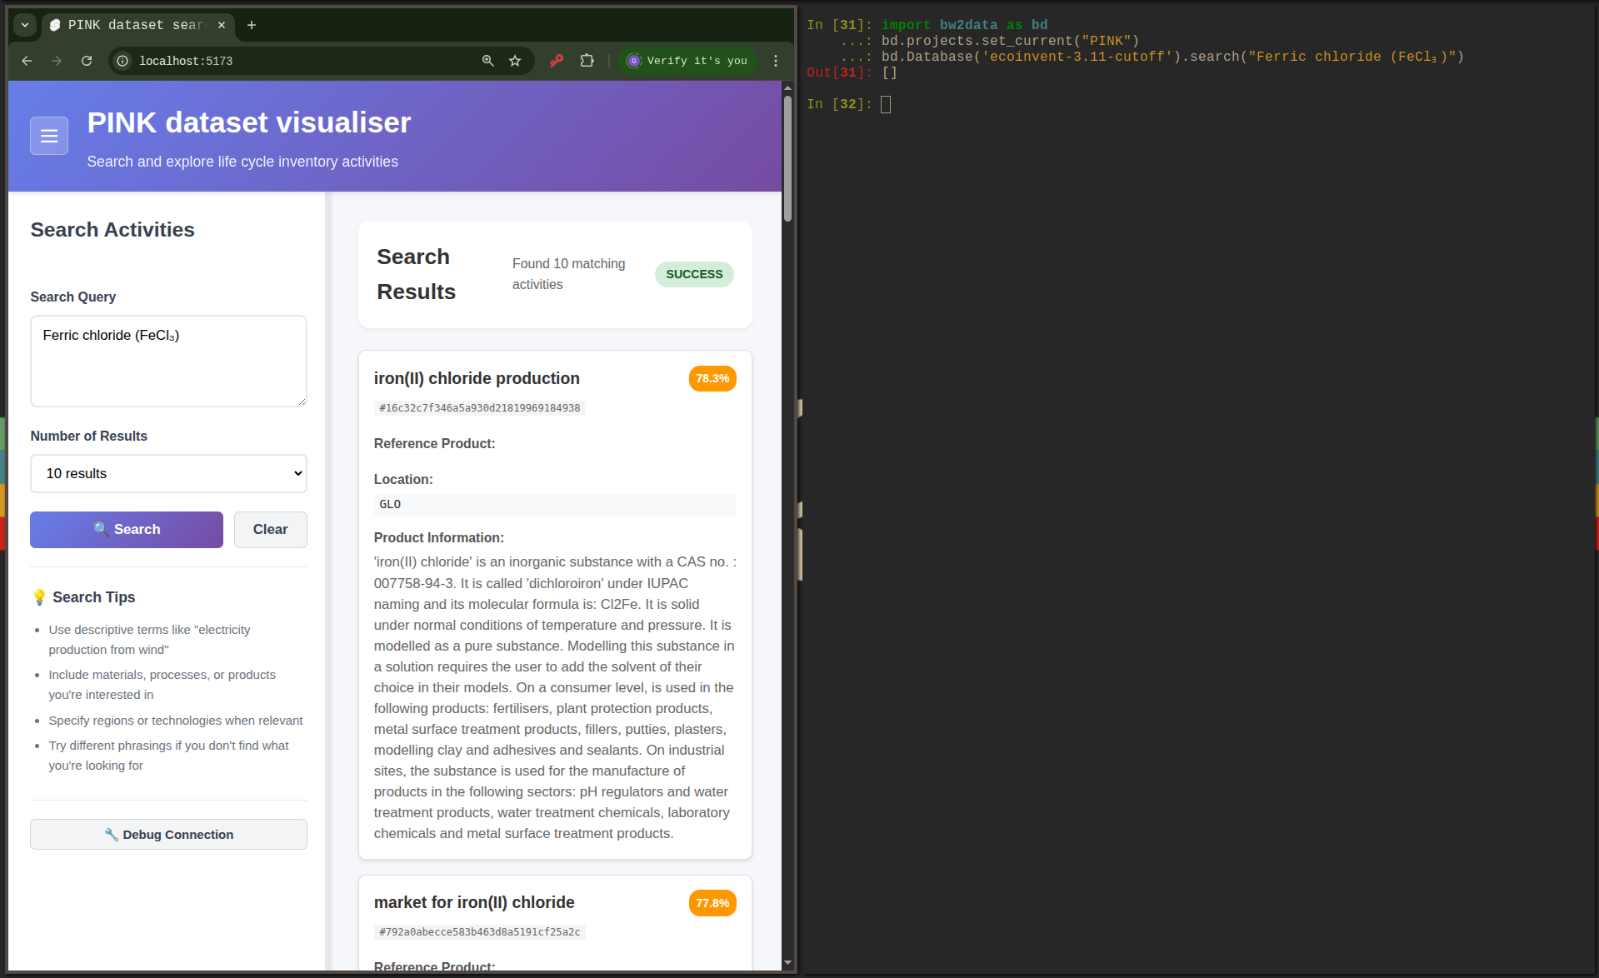
Results

Slide 18
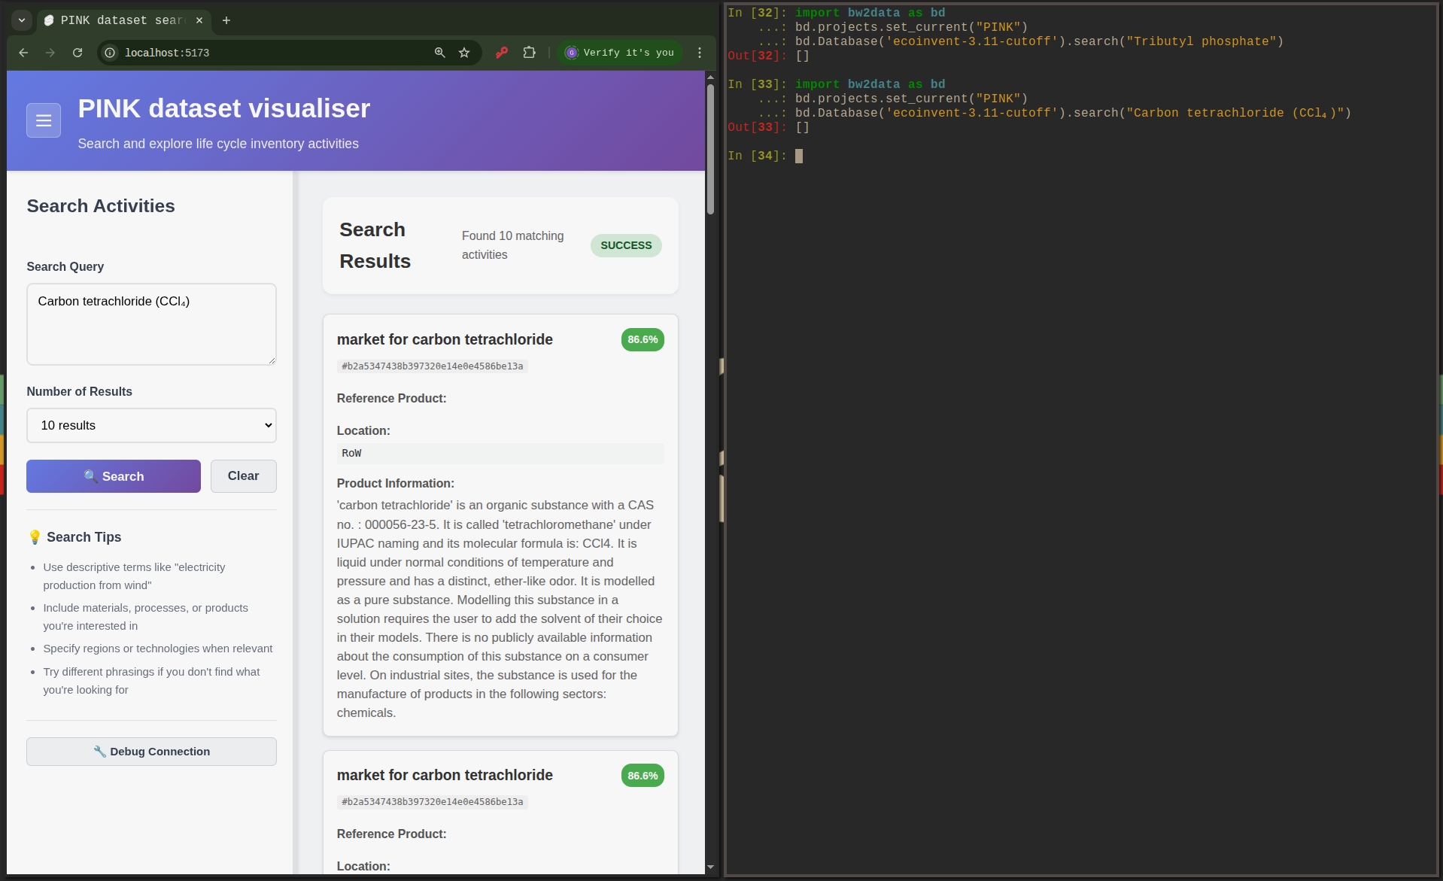
Results

Slide 19
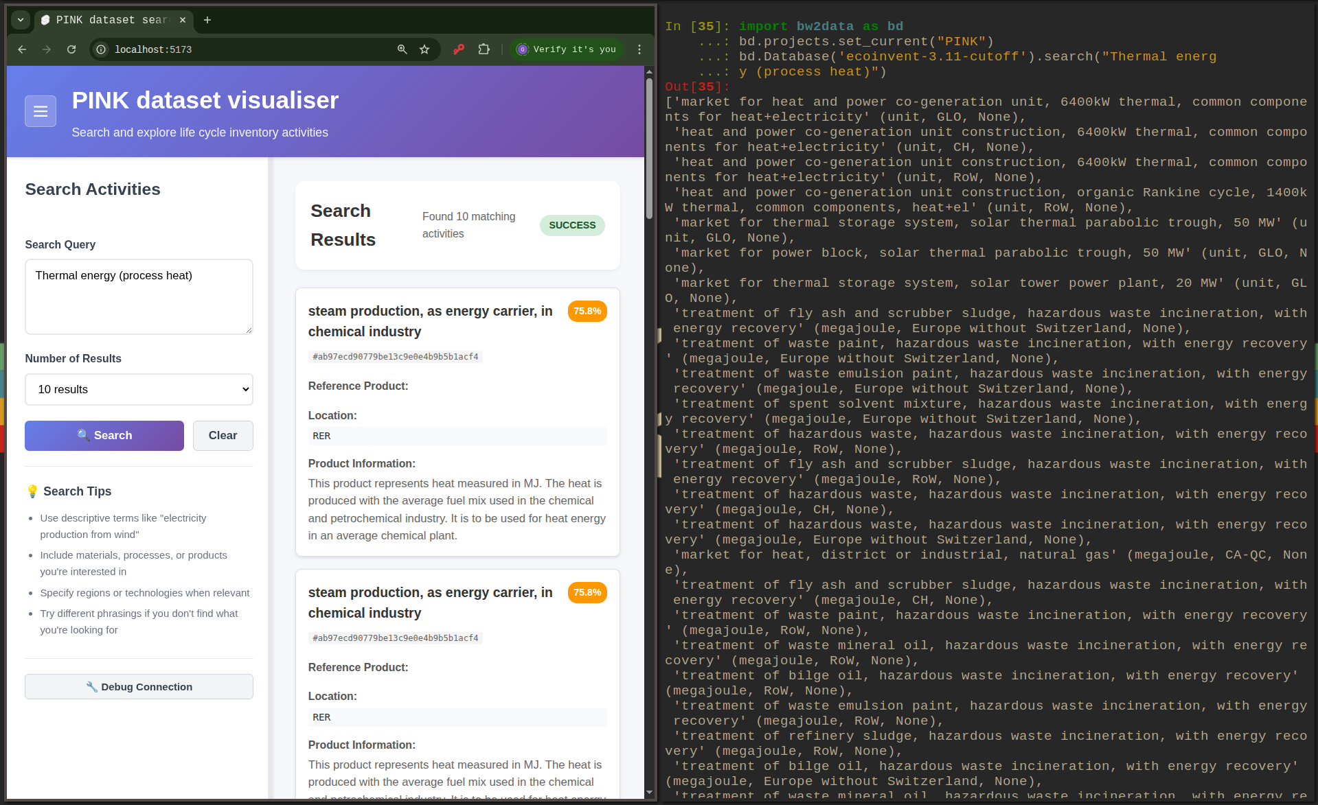
Results

