Slide 1


Slide 2
Applications of artificial intelligence algorithms and approaches in the life cycle sustainability assessment field: a topic modelling investigation based on large language models
Antonino Marvuglia, Simone Zorzan, Enrico Benetto
Luxembourg Institute of Science and Technology (LIST)

Slide 3

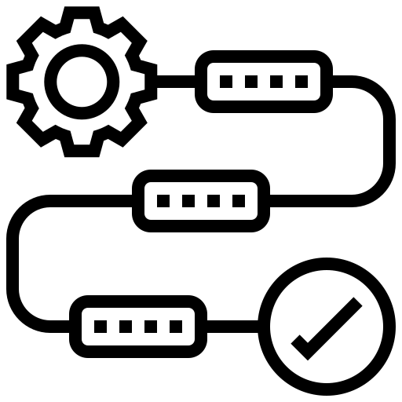


Agenda
Introduction & Research goal
Methodology
Results
Take home messages
3

Slide 4
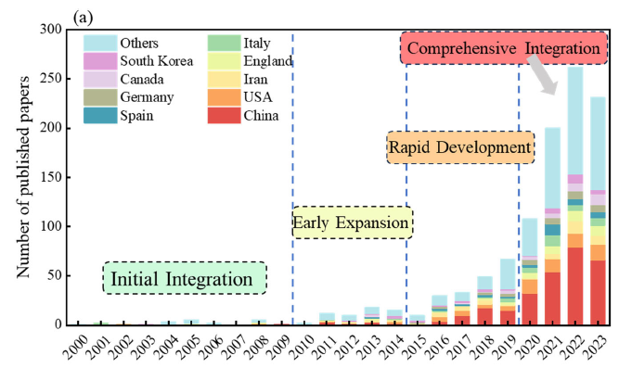

Introduction & Research goal
LCM is a data-intensive and complex process
In recent years, AI and ML have emerged as powerful approaches with high potential to accelerate LCM workflows
Several studies have highlighted this potential (Ghoroghi et al. 2022; Gong et al. 2025; Romeiko et al. 2024; Preuss et al. 2024; Neupane et al. 2025)
The number of applications is now so high, that navigating the literature itself can become a daunting task
Research goal: uncover relevant latent topics and main research trends at the intersection between AI and LCA/LCM/LCSA in the development of advanced chemicals and materials.
Source: Gong et al. 2025
HEU (2024-2027)
4
Notes:
LCM is a data-intensive and complex process heavily relying on data processing, cleaning, integration, visualization, etc.
In recent years, AI and ML have emerged as powerful approaches that can greatly accelerate LCA workflows
This is testified by the exponential growth of published papers in this area, as showed in the recently published paper by Gong et al. that details the various epochs of integration of AI in industrial ecology workflows.
This has rendered the number of applications of AI and ML so hight, that even navigating the literature itself can become a daunting task.
Our research goal was to uncover relevant latent topics and main research trends at the intersection between AI and LCA/LCM/sustainability in the development of advanced chemicals and materials.
The choice of the sector of innovative chemicals and materials as the sector of application was determined by the fact that we conducted this study within the project PINK, which is an Horizon Europe project focussed on SSbD of advanced chemicals and materials.

Slide 5
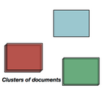

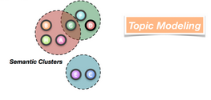
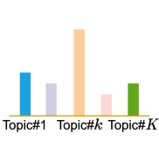
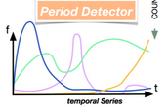


Methodology
Topic Modelling is an ensemble of techniques designed to uncover and label the underlying themes (topics) within a collection of documents (corpus).
Topics are repeated groups of statistically significant tokens or words in a corpus.
To this aim the documents are parsed, indexed, vectorised and classified in clusters.
Words or other detailed features in texts are analysed to identify topics, explore their interrelationships and map them, and track how these topics evolve over time.
An important application of topic modelling is to uncover research trends
Indexed documents
(parsed corpus)
Clusters of documents
CLASSIFY
Semantic clusters
COUNT & VISUALIZE
Doc-topic distribution
Temporal series
Topological distances
Contrastive measures
5
Notes:
To do so, we used Topic Modelling.
TP is an ensemble of techniques (ranging from probabilistic models to modern embedding-based and deep learning approaches) designed to uncover and label the underlying themes within collections of documents (corpus).
Topics are repeated groups of statistically significant tokens (that is single words or characters that results from splitting a document into smaller segments) or words in a corpus.
To this aim the documents are parsed, indexed, vectorised and classified in clusters according to the general topics.
Words or other detailed features in texts are analysed to identify recurring (statistically significant) themes, explore their interrelationships, and track how these themes evolve over time.
In fact, an important application of topic modelling is to uncover research trends
We used Topic Modelling. TP is a common technique used in academic research articles to analyse large textual datasets and discover latent topics within the data [7]. In essence, topic modelling is a NLP method that analyses text to identify patterns in word usage by classifying groups of similar words into ‘topics’ [8]. An important application of topic modelling is to uncover research trends [9,10].
Semantic insights are often drawn from the patterns of word and document co-occurrences.
It can be viewed as a technique for reducing the complexity of data by summarizing large text corpora into thematic dimensions.
Topic Modelling is an information mining tool that identifies Topics in a corpus leveraging statistical and machine learning methods (ranging from probabilistic models (such as LDA) to modern embedding-based and deep learning approaches) to highlight the most prominent ones
Topics are repeated groups of statistically significant tokens or words in a corpus
Statistically significant means:
- Groups of words occurring together in the documents
- Have similar term and inverse document frequencies intervals (TFI and DFI)
- Frequently occurring together
Prominent tropics are essentially the ones that are the most statistically significant
A LLM is a sophisticated mathematical function that predicts what word comes next for any piece of text

Slide 6













Methodology
We manually collected 50+ EU and national reports focused on several aspects of AI and LCA in Europe.
We queried Scopus and WoS for research papers (18 February 2025).
AI strategic vision reports
Others
TITLE-ABS-KEY ( "artificial intelligence" OR "machine learning" OR "generative AI" OR "data driven" OR "data-driven" OR "large language model" ) AND ( TITLE-ABS-KEY ( "life cycle assessment" OR "life cycle analysis" OR "life cycle management" OR "industrial ecology" OR “life cycle sustainability assessment" OR "Safe and Sustainable by Design" OR "safety and sustainability by design" OR "SSbD" OR "advanced chemicals" OR "advanced materials" OR "advanced materials and chemicals" OR "advanced chemicals and materials") ) AND PUBYEAR > 2014 AND PUBYEAR < 2025 AND ( LIMIT-TO ( DOCTYPE , "ar" ) ) AND ( LIMIT-TO ( LANGUAGE , "English" ) )
Synthetised query: "English-language research articles (2014–2025) on the intersection of AI and (LCA/LCM/LCSA) in advanced chemicals and materials"
1761
695
2456
For Topic Modelling: How do abstracts and full texts compare / can AI help?
Which research papers are relevant?
6
Notes:
To create our corpus, we manually collected a number of EU and national reports focused on several aspects of AI and LCA in Europe.
We also queried Scopus and WoS to collect research papers. The last query was launched on the 18th of February 2025.
This is the full query, but we can synthesize it as follows:
Find "English-language research articles published between 2014 and 2025 that are at the intersection between AI and (LCA/LCM/sustainability) in advanced chemicals and materials“
The query resulted in 2546 papers of which about 70% came from Scopus and 30% from WoS
We quickly had to phase two main problems:
1) In large and rapidly growing corpora of research, which papers among those fetched by the selected query are actually really relevant for our research goal?
2) Once we select a corpus only of relevant papers, how does the TM conducted only on abstracts compare with the one conducted using the full text of the papers? Is there a real advantage in using the full texts?
- AI strategic vision reports of the EU Member States under the Coordinated Plan on Artificial Intelligence;
- Reports featuring “machine learning” or “artificial intelligence” in the Policy Commons website;
- Policy papers featuring “machine learning” or “artificial intelligence” from the OECD;
- Communications and white papers from the European Commission on AI, and documents from the High-level expert group on AI set up by the European Commission;
- National policy documents from the Government of the Grand Duchy of Luxembourg;
- JRC technical reports on AI;
- Other documents fetched from a Google search with the same query used in WoS (these include industry reports, reports from the National Renewable Energy Laboratory of the U.S. Department of Energy, etc.).
https://digital-strategy.ec.europa.eu/en/policies/plan-ai
https://policycommons.net/

Slide 7






Which papers are relevant?
Evaluating the pertinence of 2456 research papers is a time-consuming process.
We used AI to automatically screen relevant papers.
Verdict: Not-relevant
Explanation: The paper compares ML techniques for agri-food sustainability but does not detail their application in calculating environmental impact scores (e.g., CO₂ emissions) or lifecycle assessments in a practical case study, as required by inclusion criterion d.
While it mentions energy savings, it lacks the specific calculations that tie them directly to environmental impact reductions.
Test AI on a sample
Define prompt
1
We tested AI (Gemini) on a subset of 200 papers and checked the coherence with the advice of a human field expert.
AI provided verdict and explanation.
After screening several dozens of papers, we defined a prompt to describe how to select relevant ones (inclusion and exclusion criteria).
3
2
Check results
154 highly relevant papers
(out of 2456)
We adjusted the prompt based on the reasons provided by the AI (Google Gemini API) and the agreement with human expert.
We reached a stable agreement of 92%
7
Notes:
The reports were not very numerous, and we could quickly realise that they were certainly relevant to the aim of our research.
But evaluating manually the pertinence of 2456 research papers would result in a very time-consuming process.
We reached a stable agreement of 92% (of which 95% agreement on the files that Gemini discarded, and 70% on agreement on the files that Gemini retained)

Slide 8


BERTopic and KeyBERT
A powerful technique that leverages modern AI to find topics by clustering documents based on their semantic meaning.
Key Advantages:
Understands Context: Uses embeddings (like BERT) to grasp nuances beyond simple word counts.
Adjustable Topic Number: Finds the optimal number of topics automatically (no guesswork needed). The user can also tweak the parameters to obtain a certain number of topics.
Filters Out Noise: Identifies and separates irrelevant documents as outliers.
Intuitive Results: Reformulates topic names to obtain more interpretable names based on documents’ semantics using KeyBERT or Language Models (typically online).
Keywords generator for topic names’ reformulation using embeddings (more energy efficient than online LLMs).
8
Notes:
We used BERTopic to perform the analysis, which is a powerful TM technique that leverages modern AI to create dense clusters allowing for easily interpretable topics.
The key advantages of BERTopic are:
That it understands the context: Uses embeddings (like BERT) to grasp nuances beyond simple word counts
It has an adjustable Topic Number: Finds the optimal number of topics automatically (no guesswork needed like in more traditional approaches like the Latent Semantic Analysis (LSA) and the Latent Dirichlet Allocation (LDA), where you have to set up the desired number of topics in advance). The user can also tweak the parameters (min_topic_size, min_topic_number) to obtain a certain n. of topics.
In our case, for the full texts we used the automatic n. of topics (58). For the abstracts we needed to adjust the parameters to obtain a reasonable set of topics, which resulted in 18 topics.
It Filters Out Noise: Identifies and separates irrelevant documents as outliers
It gives intuitive results: Reformulates topic names based on documents’ semantics using KeyBERT or Language Models (typically online).
We used KeyBERT because, given the relatively low number of topics extracted (as you’ll see in a couple of slides) it was more efficient and less energy intense (it just used less than 1/10 of our resources– a server with 56 core CPU).
It generated topic names using embeddings from transformer encoders like BERT
In essence, instead of giving a long sentence to describe a topic, like a LLM would do, KeyBERT gives more interpretable and focussed keywords to describe each topic. In this way, the expert can then also check if those keywords make sense. This is feasible when we have a low number of topics. If we had a large number of topics (like hundreds of topics). In that case it would be better to use the sentences coming from the LLM.
KeyBERT extracts keywords by using embeddings from transformer encoders like BERT (Bidirectional Encoder Representations from Transformers), which are smaller, non-generative relatives of today’s LLMs;
It represents a focused application of the same underlying transformer technology, but not a large language model itself. In BERTopic, KeyBERT is often used to generate representative keywords for clusters of documents, linking transformer-based embeddings with topic modeling in a way that remains adjacent to, but distinct from, full-scale LLM approaches.

Slide 9


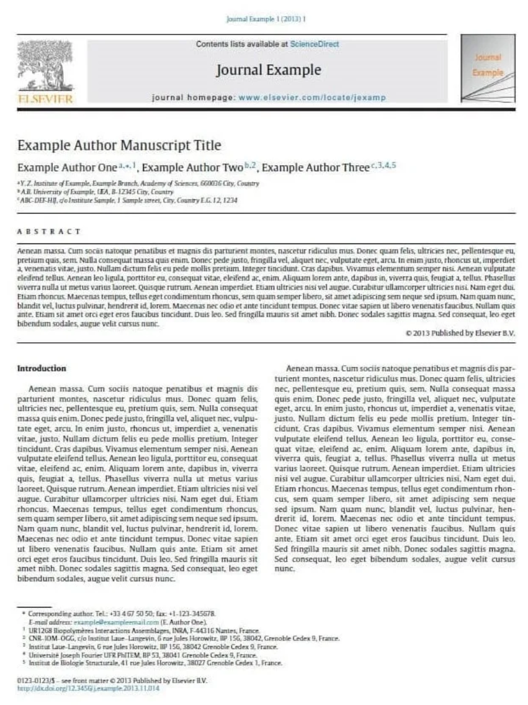

Corpus creation strategy
ABSTRACT
OR
?
OR
?
ABSTRACTS
FULL TEXTS
SCIENTIFIC PAPERS
REPORTS
SCIENTIFIC PAPERS
REPORTS
Full texts: ~30.000 – 64.000 characters for papers (up to 10x for reports), subdivided in “chunks” of 580 characters (each chunk becomes a document).
  The 10k+ chunks obtained were treated as single documents, while maintaining the link to the original document
  Text was manually cleaned from PDF conversion artefacts, bibliographies, URLs, file-related text, etc. to reduce noise in topic definition
Abstracts: ~400 - 800 characters, processed adjusting the parameters of BERTopic to deal with only 154 documents (compared to the high number of chunks)
  Reports’ abstracts generated by AI (via Google Gemini API)
Text content
Chunks of text
Notes:
Remember the two main problems we had at the beginning.
To answer them we had to run the modelling pipeline that I will show you in the next slide
But let’s start from our documents.
Full texts have ~30.000 – 64.000 characters for papers (up to 10x for reports). To work with them, they were subdivided in “chunks” of 580 characters with a windows sliding 280 characters at a time (each chunk becomes a document, resulting in about 10k chunks).
The rationale is that a full text contains section and paragraphs and can related to multiple topics
Chunks were treated as single documents, while maintaining the link to the original document
Text was manually cleaned from PDF conversion artefacts, bibliographies, links, file-related text, etc. to reduce noise in topic definition

Slide 10

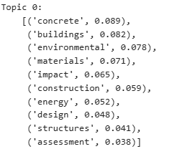
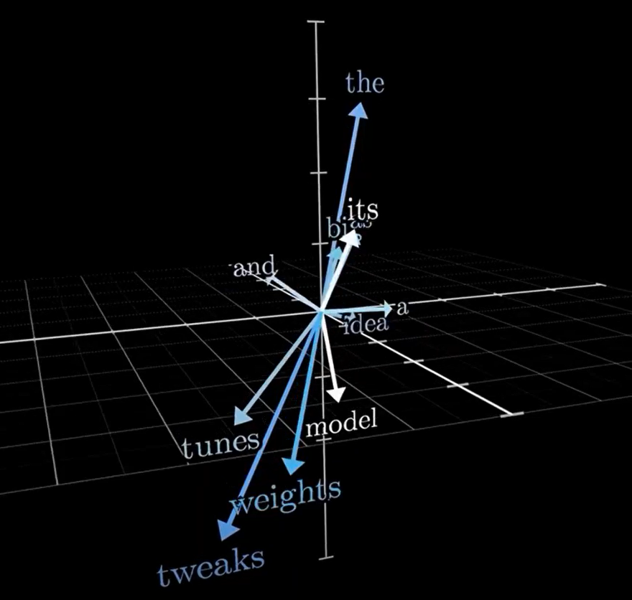
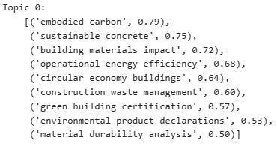
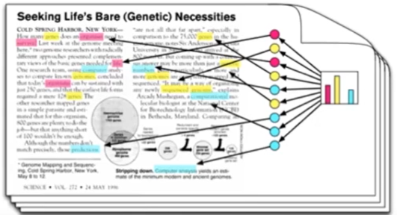

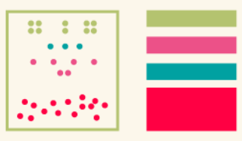
Topic modelling pipeline
We cast each abstract or chuck to a numerical coordinate into a highly-dimensional space
(1)
Embeddings
(6)
AI fine tuning
Preliminary topics are submitted to AI (KeyBERT) to obtain more interpretable topics
(2)
Dimensionality reduction
(5)
Weighted scheme
Find most statistically relevant terms
Dimensions were reduced to facilitate clustering
(3)
Clustering
(4)
Tokenizer
Embeddings are clustered to prepare a set of documents and extract topics
Subdivides documents into words or n_grams and prepares for topic selection
e.g. N=3 Trigram
life
cycle
assessment
10

Slide 11
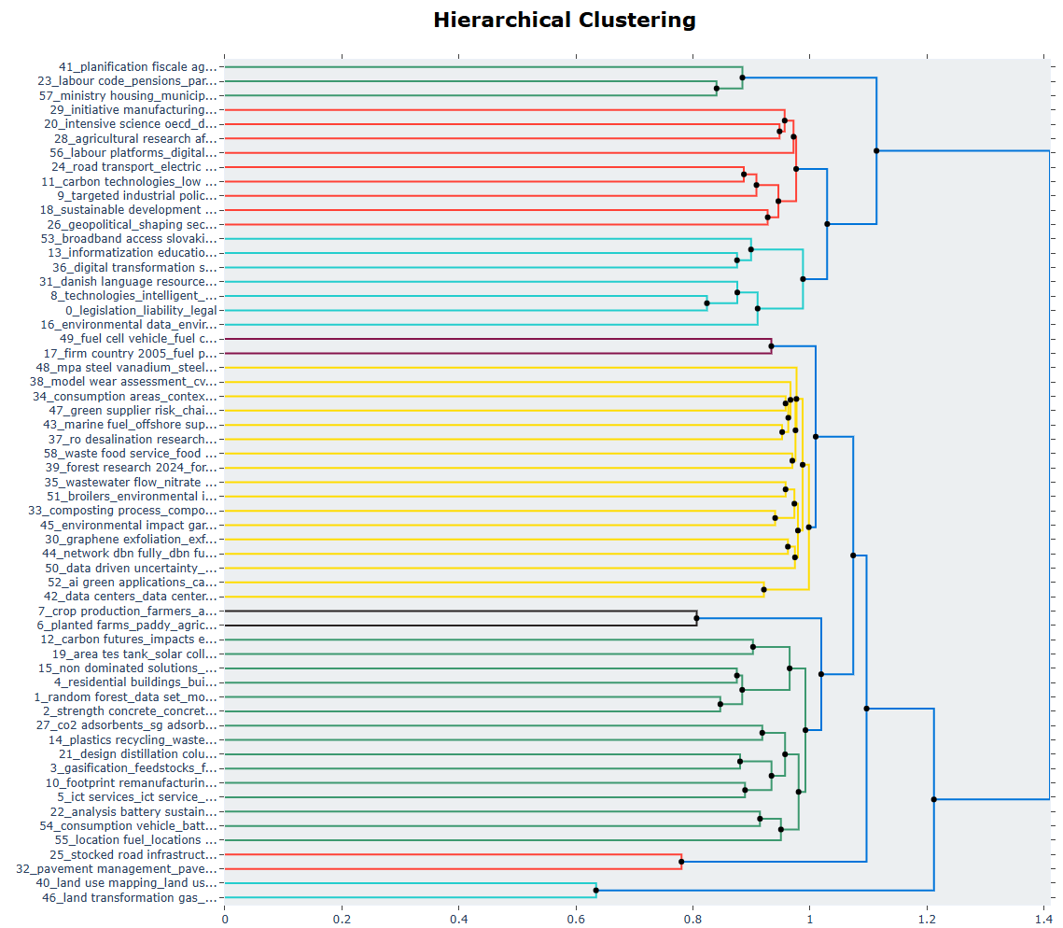
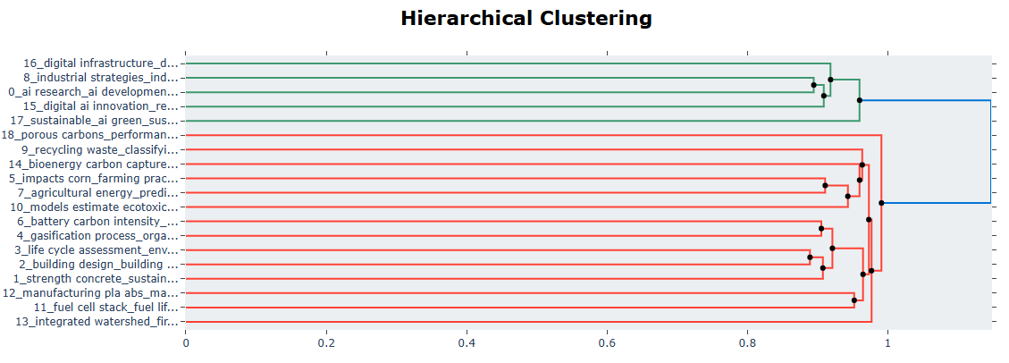
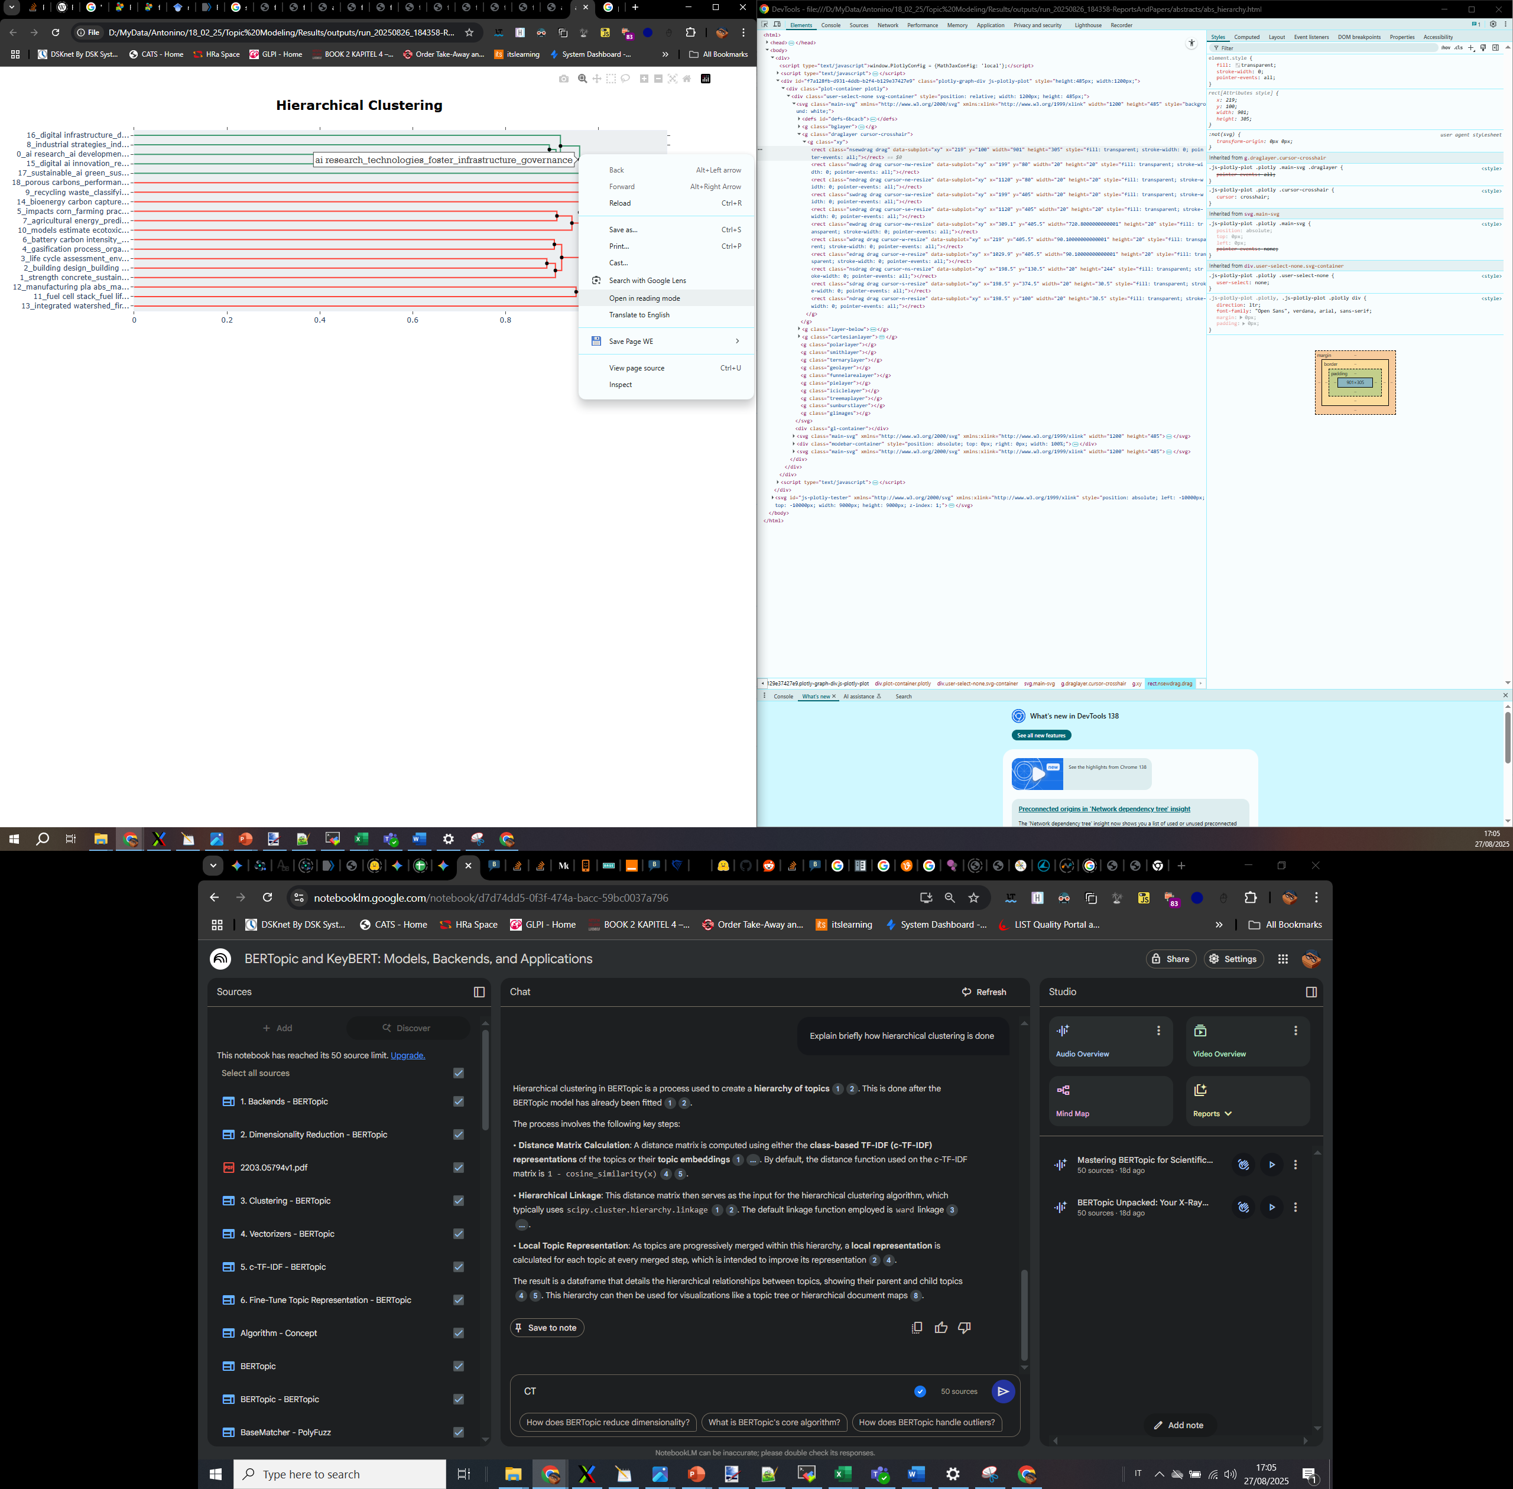
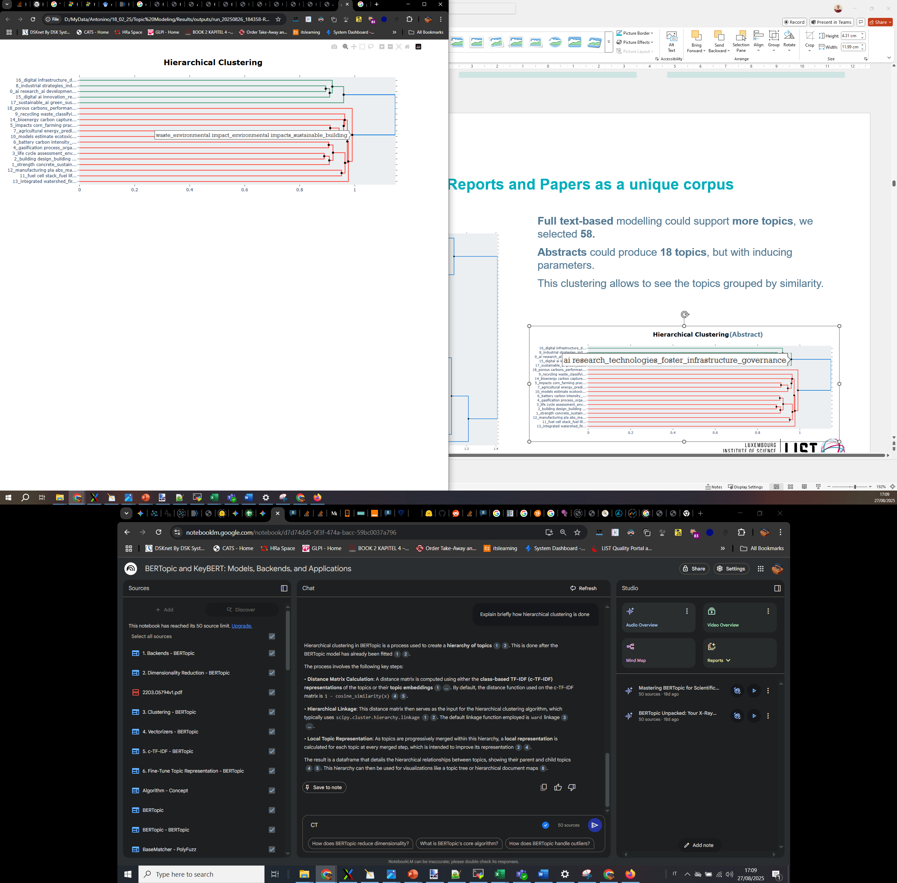
Reports and Papers as a unique corpus: hierarchical clustering
(Full texts)
The clustering is done with the HDBSCAN algorithm.
HDBSCAN clustering allows to see the topics grouped by similarity.
The two clustering identify similar global topics, but full text allows for more granularity and interpretability.
Full text-based modelling could support more topics, we selected 58.
Abstracts evoked 18 topics, obtained by modifying the parameters.
Hovering on nodes we can appreciate “grouped” topics.
58 topics
(Abstracts)
18 topics
Notes:
The clustering is done with the HDBSCAN (Hierarchical Density-Based Spatial Clustering of Applications with Noise) algorithm, which is a hierarchical algorithm.
On the left side you see the clustering obtained on the full texts, while on the bottom-right side of the slide you can see the clustering obtained with the abstracts only.
HDBSCAN clustering allows to see the topics grouped by similarity.
We can see from the pictures that the two clusterings identify similar global topics, but full text allows for more granularity and interpretability, which is a consequence of the higher number of topics that are obtained.
As I said before, in our case, working with the full texts we could obtain more topics; we selected 58.
With abstracts, by tweaking the parameters of the algorithm, we managed to produce 18 topics.
The output is an html file where, if you hover over the nodes you can appreciate “grouped” topics.
For example, here we can see the two main topics that represent prevalently the content of the reports (on top) and the scientific papers (at the bottom).
But you can also explore other sub-topics.
Also in the Abstract’s corpus you see the same main two topics, one related prevalently to the reports and the other prevalently related to the papers (top and bottom), but clearly with less granularity on the possible sub-topics.

Slide 12
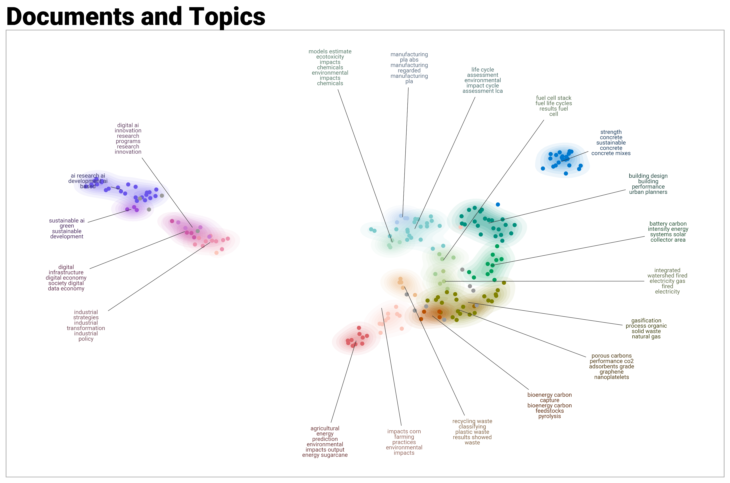
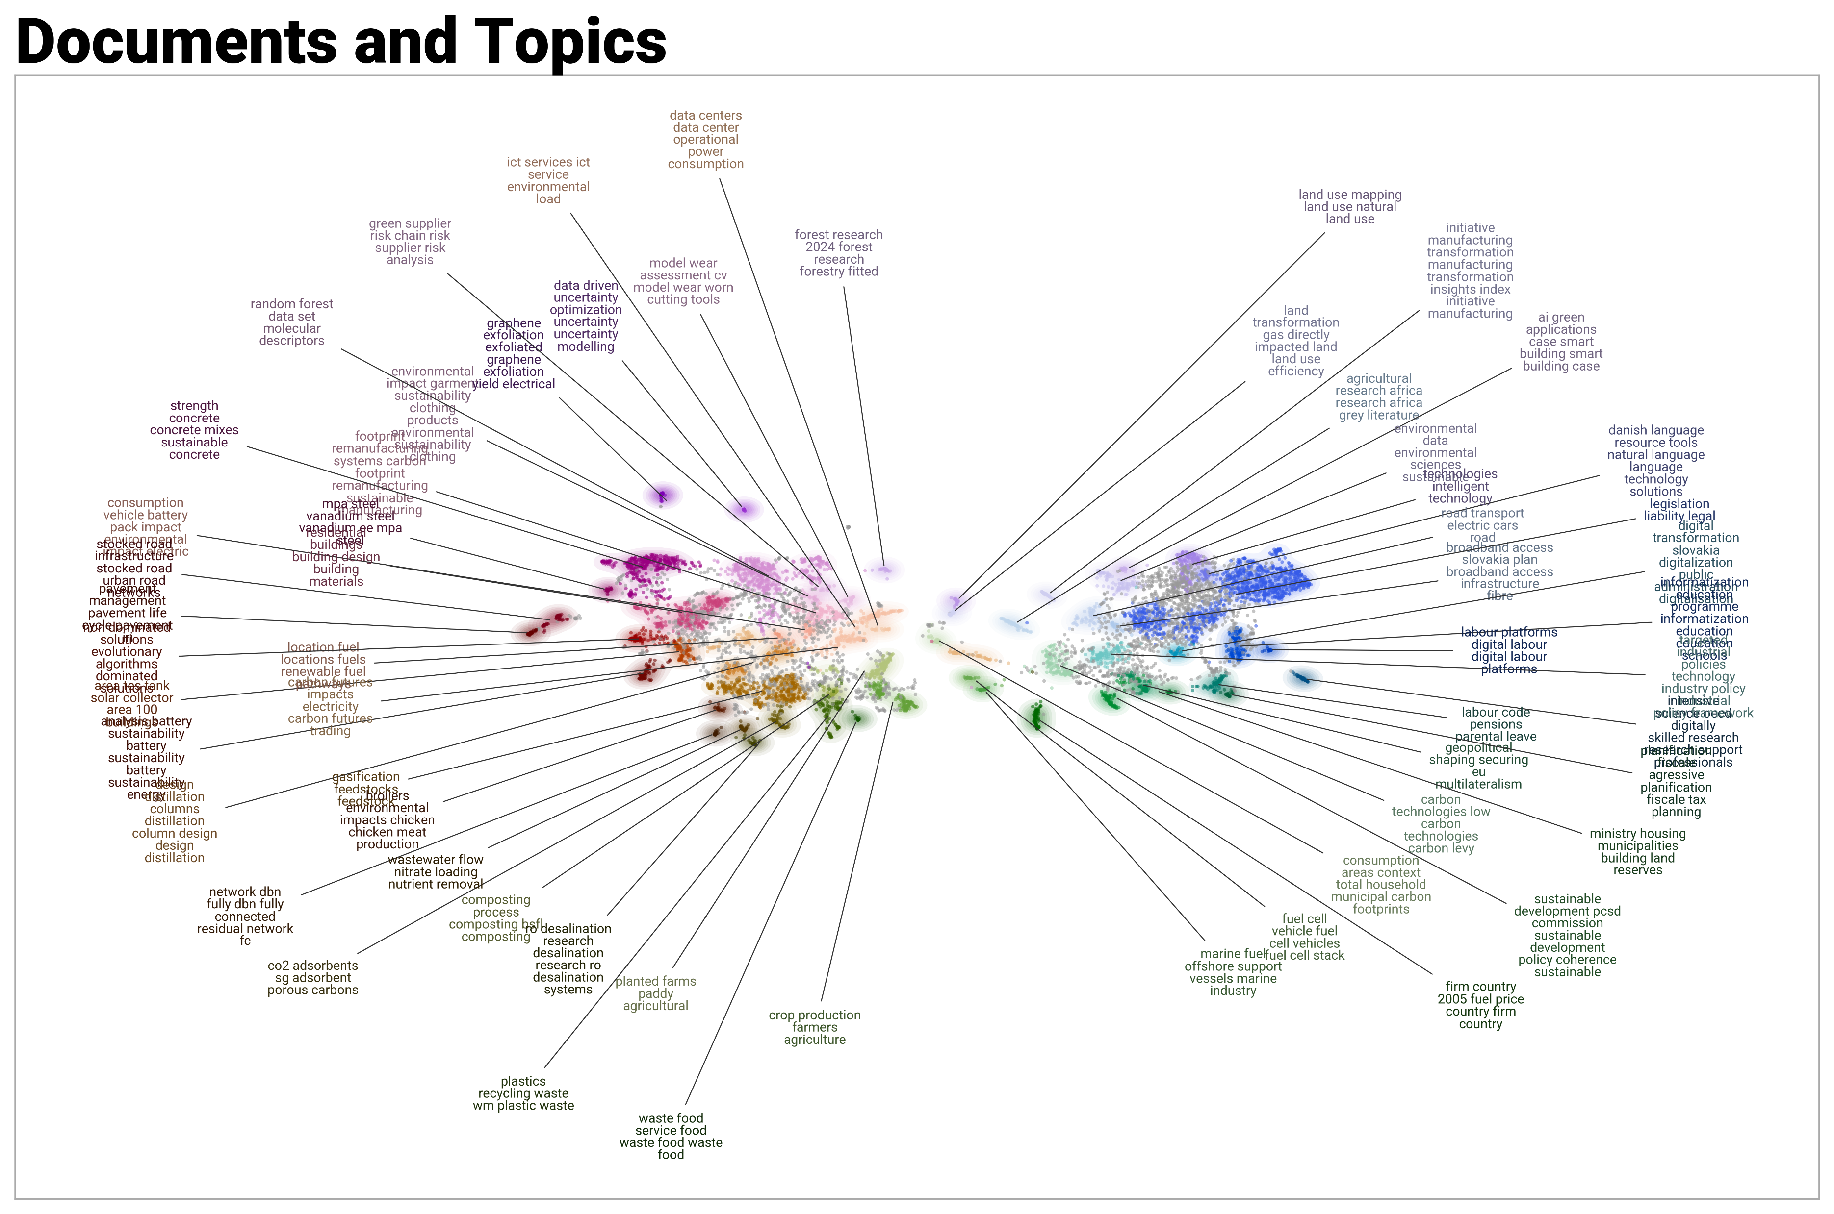
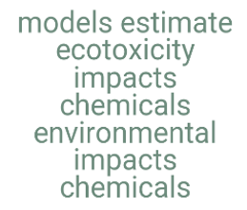
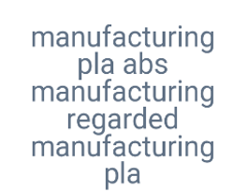


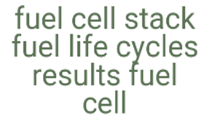
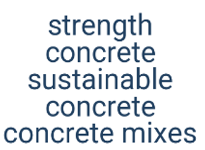
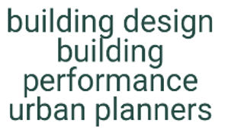



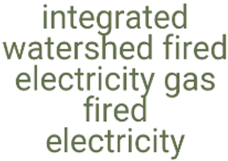


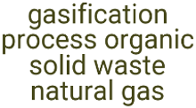
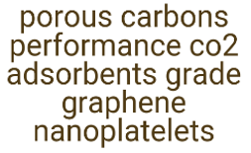
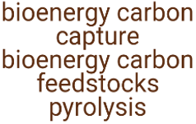
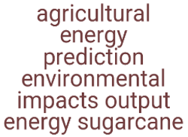

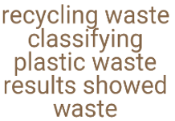
Reports and Papers as a unique corpus: UMAP projection
Topics clusters from Abstracts
Topics clusters from Full Texts
Topics from papers
Topics from reports
Topics from papers
Topics from reports
Notes:
Without going into much detail, also in this visualization (obtained using the UMAP – Uniform Manifold Approximation and Projection- algorithm), we can see that there is clearly a group of topics that are more related to the reports and another group that is more related to the scientific papers.
And this happens both in the case where we conduct the analysis using only the abstract (left) or using the full text chunks (right), with more topics in the latter case.
Full text provide a more nuanced model, with substantially all topics produced by the abstracts represented by the full text models.

Slide 13
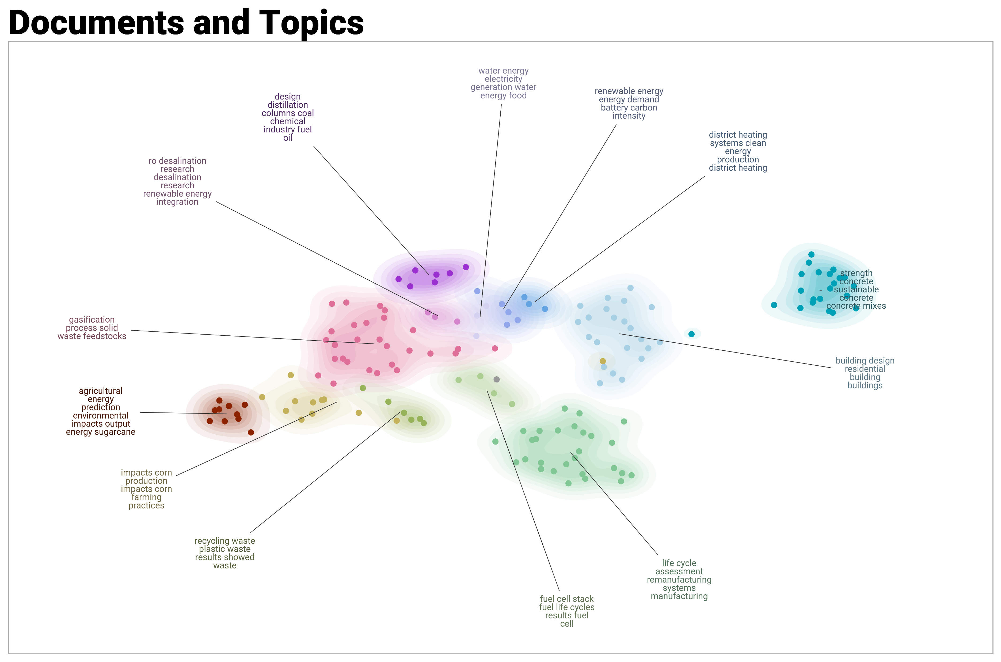
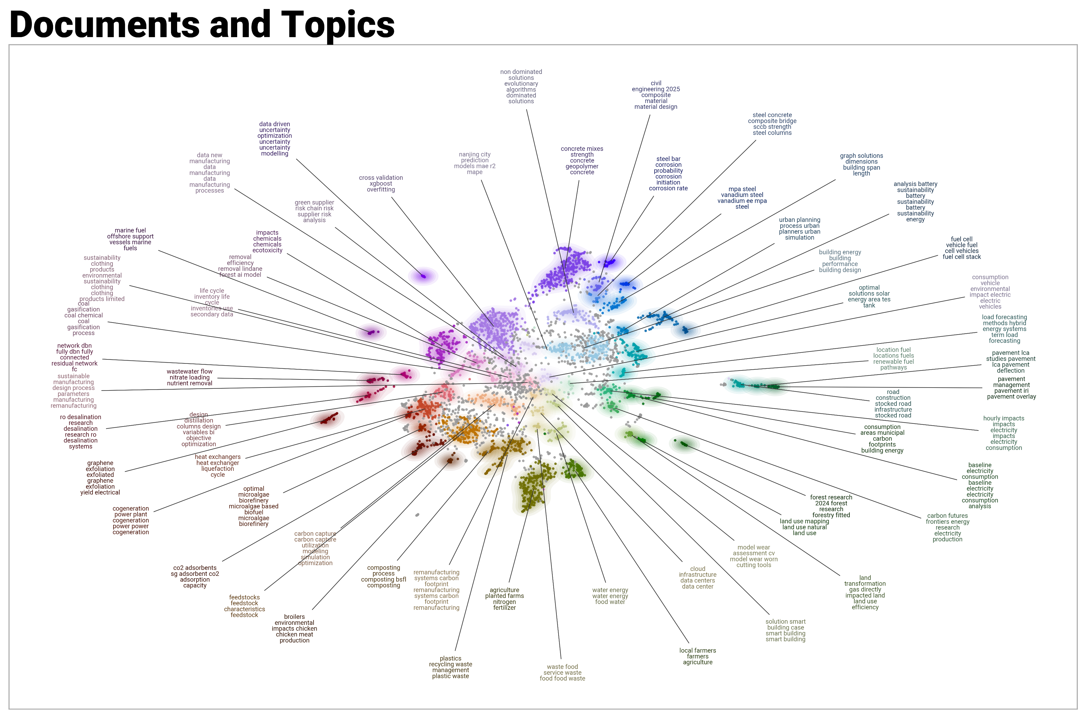
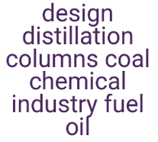


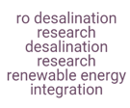


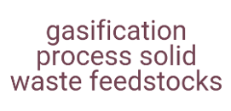
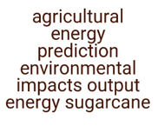

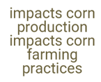

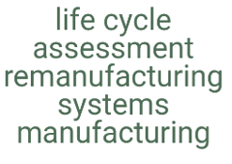

Only Papers
Topics clusters from Abstracts
Topics clusters from Full Texts
concrete mixes_strength concrete_geopolymers
strength
concrete
sustainable
concrete
concrete mixes
heat exchangers_h2 liquefaction system
Notes:
We decided to focus on papers, because of the separation in the topic analysis.
The pipeline analysis was applied to the 154 papers selected by the AI screening

Slide 14
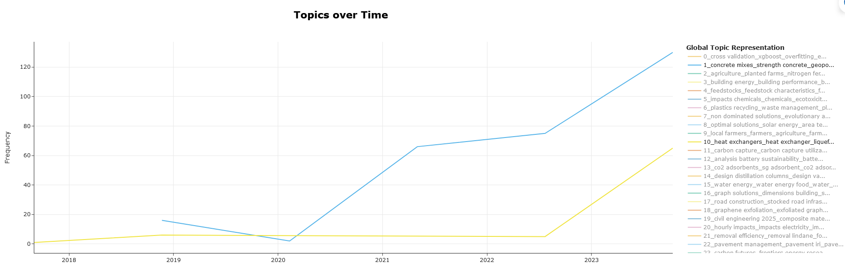
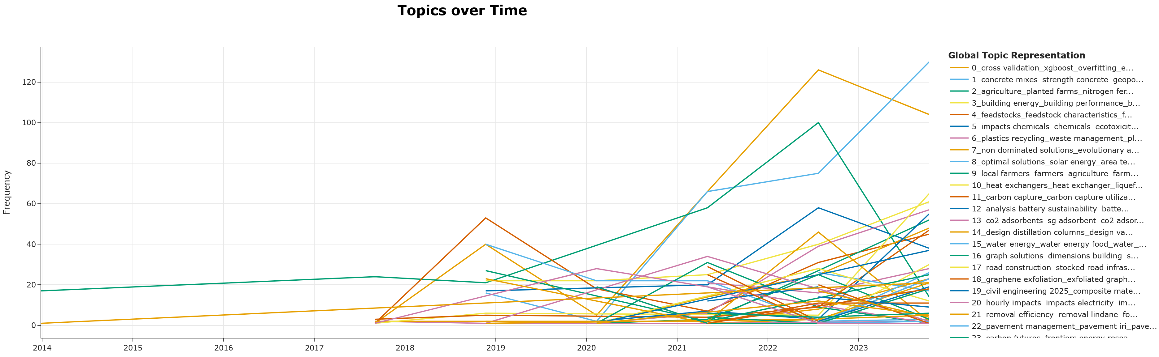
Time evolution of the topics
Topic 1: concrete mixes_strength concrete_geopolymers
Topic 10: heat exchangers_h2 liquefaction system

Slide 15
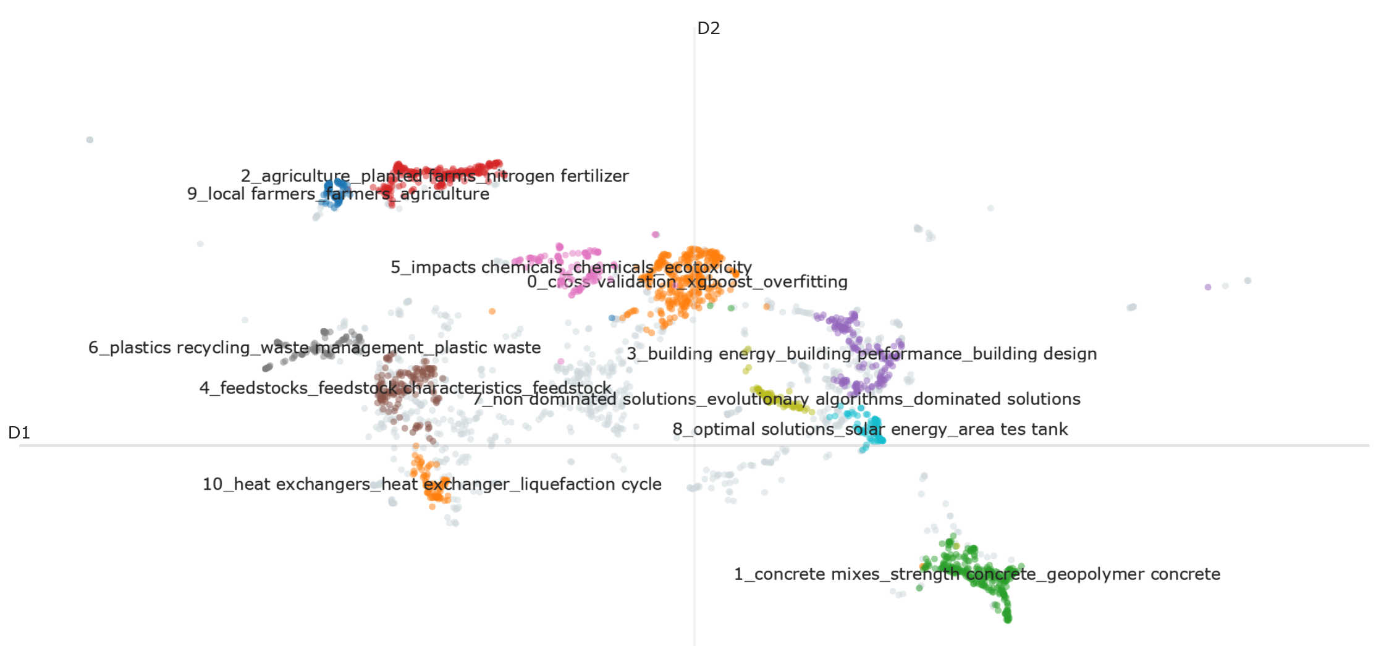
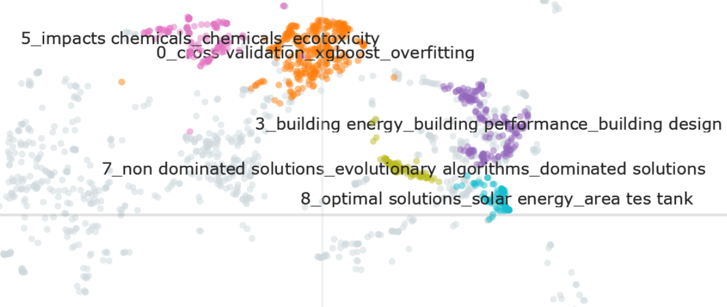
AI topics proximity to LCM topics
Topic #5 ['impacts', 'chemicals', 'ecotoxicity', 'pollution', 'environmental risk assessment', 'toxicology/toxicity', 'exposure', 'monitoring/assessment' , 'regulation/policy']
Topic #0 ['xgboost', 'overfitting', 'prediction', 'decision trees', 'model evaluation', 'generalization', 'training data', 'parameter tuning']
Notes:
To understand if there were specific AI methos particularly used in certain sustainability applications we verified the association chunk-wise and document-wise (we reassociated each paper to its own topics)
The analysis reveals patterns, showing that the field is applying specific AI tools to solve problems in LCA, particularly around data complexity and optimization.
The figure shows the first 10 topics, which are also the most important ones (because remember that the higher the number of the topic, the lower its importance)
The proximity of Topic 0 (cross validation_xgboost_overfitting) to Topic 5 (impacts chemicals_chemicals_ecotoxicity) on the BERTopic map paints a clear picture of applied data science in environmental risk assessment.
Likewise, we can see the proximity between Topic 3 (building energy_building performance_building design) and the Topics 7 (related to evolutionary algorithms) and 8 (related to optimization and solar energy).
This reveals that the sophisticated computational tools of evolutionary algorithms are being widely employed for the optimization of solar energy integration and holistic building design and performance.

Slide 16
Take home messages
For niche research areas commonly used queries (AND/OR+keywords) can lead to inflated results
Prompt design plays a very important role (e.g. use the full list of impact categories)
Careful manual cleaning of the text to exclude noise is very important
KeyBERT is a more energy efficient alternative to LLMs (hosted online or even on premise) and in our case allows more detailed (meaningful) topic names
Analysing only scientific papers and using full texts (instead of abstracts) has the advantage of providing more focused topics and more granularity in topic analysis
Using also industrial reports (non freely available) would have probably revealed more interesting connections with the topics emerging from the scientific papers
Notes:
Prompt’s design plays a very important role. For example, we realised that mentioning among the inclusions criteria a full list of environmental impact indicators (e.g., biodiversity, human health, acidification, eutrophication, etc.), instead of only CO2-equivalent emissions or generically mentioning the impacts on “sustainability indicators”, improved the agreement between Gemini’s verdict and my evaluation by more than 30%.
Careful manual cleaning of the text to exclude noise is very important.
KeyBERT is a more energy efficient alternative to LLMs (hosted online or even on premise) and in our case allows more detailed (intelligible) topics.
Analysing only scientific papers and using the full texts instead of only the abstracts, ultimately allows more granularity in topic analysis.
Finally, I spend a word about the reports. Their use didn’t seem to highlight important topics that would have been difficult to guess without the TM. However, we have to say that we used only about 60 reports. But using also industrial reports (which were not freely available) would have probably revealed more interesting connections with the topics emerging from the scientific papers.

Slide 17
Cited references
Ghoroghi et al. 2022. Advances in application of machine learning to life cycle assessment: a literature review. Int. J. Life Cycle Assess. 27, 433–456. https://doi.org/10.1007/s11367-022-02030-3.
Gong et al. 2025. The evolution of research at the intersection of industrial ecology and artificial intelligence. J. Ind. Ecol. 1–18. https://doi.org/10.1111/JIEC.13612.
Romeiko et al. 2024. A review of machine learning applications in life cycle assessment studies. Sci. Total Environ. 912, 168969. https://doi.org/10.1016/J.SCITOTENV.2023.168969.
Neupane et al. 2025. Machine learning algorithms for supporting life cycle assessment studies: An analytical review. Sustain. Prod. Consum. 56, 37–53. https://doi.org/10.1016/J.SPC.2025.03.015.
Notes:
LCM heavily relies on data processing, including data collection, cleaning, integration, and conversion into a suitable structure for analysis to uncover meaningful patterns and relationships
By enhancing these data processing capabilities AI and ML can improve the effectiveness of LCM
In recent years, AI and ML have emerged as powerful approaches that can greatly accelerate LCA workflows

Slide 18
antonino.marvuglia@list.lu
This work was financially supported by the project PINK (Provision of Integrated Computational Approaches for Addressing New Markets Goals for the Introduction of Safe-and-Sustainable-by-Design Chemicals and Materials), which has received funding from the European Union’s Horizon Europe Research and Innovation Programme under grant agreement No. 101137809
Credit: Icons downloaded from: https://www.flaticon.com/free-icons

Slide 19
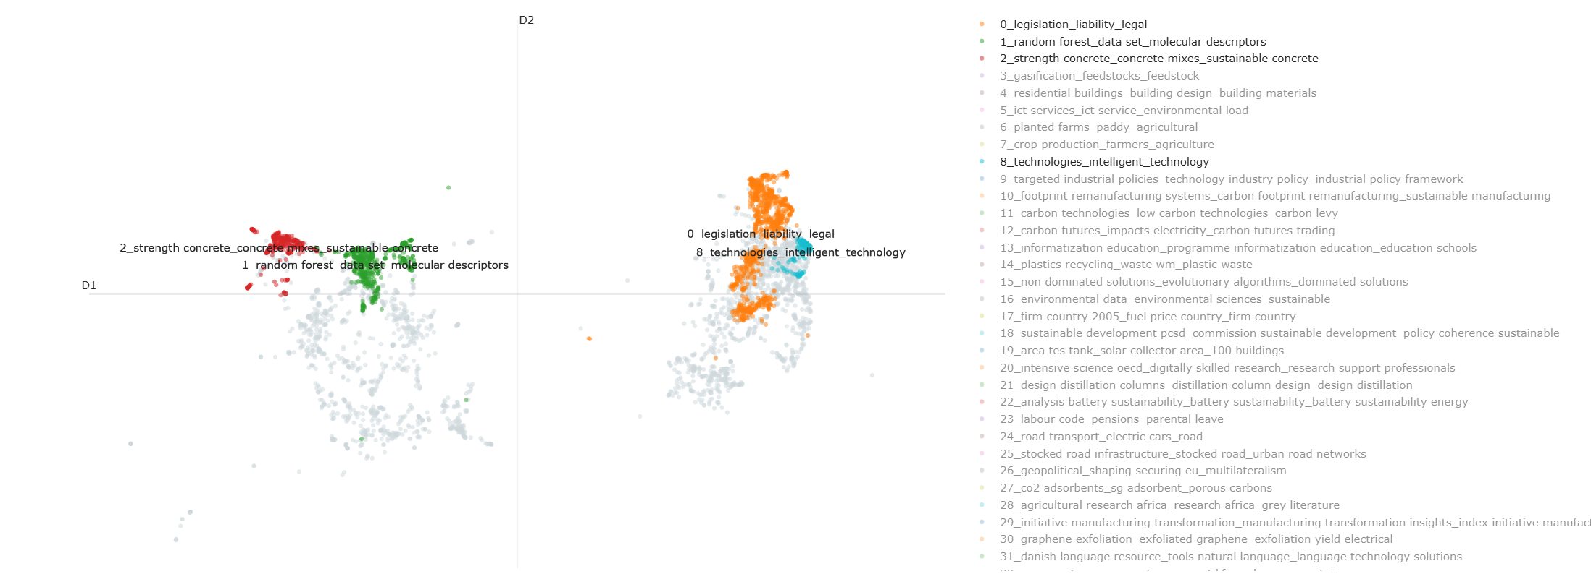
Reports and Papers as a unique corpus (full texts)
The separation between papers and reports is clearly visible also in this visualisation.
Topics from reports
Topics from papers
Notes:
Without going into much detail, also in this visualization, we can see that there is clearly a group of topics that are more related to the reports and another group that is more related to the scientific papers.
And this happens both in the case where we conduct the analysis using only the abstract (left) or using the full text chunks (right), with more topics in the latter case.

Slide 20
Prompt used for Gemini
prompt v3.3 = (
Carefully analyse this PDF document.
Provide the top 10 keywords sorted by relevance, separated by '***'.
If you find fewer than 10 meaningful keywords, do your best to find all that apply, but aim to provide 10 in total. Avoid extraneous text.
Then, add the string “XXXXX” and write is yes or no to express if this paper relevant to a research based on the following criteria:
1. Inclusion criteria that must all be satisfied:
a) The research literature we want to explore focuses on the practical applications of machine learning and artificial intelligence tools [….];
b) and the papers is addressing sustainability-related consequences, such as reductions in CO2-equivalent emissions (i.e. carbon emissions) or at least one environmental impact score […];
c) and if the paper is focused on the optimization […], then the paper provides a clear and explicit explanation of the link between these optimizations and the improvement of the environmental performances […];
d) and the paper details a case where ML is used and the study explicitly calculates carbon emissions or at least one environmental impact score [….].
2. Exclusion criteria:
a) The paper only mentions artificial intelligence or machine learning as possible tools for future research without describing their applications in sufficient detail. For example, if the paper cites other documents applying these techniques without detailing their methods, it should be excluded.
b) The term 'data-driven' is used only in the context of data collection (e.g., surveys) without applying machine learning algorithms to process large datasets.
c) 'Life cycle management' is used only to describe the service life of a machine or process, not the environmental impact assessment of its entire lifecycle.
d) The paper does not explicitly target sustainability, particularly in the context of 'life cycle assessment' or 'life cycle management,' and instead focuses only on system technical or economic optimization, improvements of physical and mechanical properties of a product.
So, provide the top 10 keywords sorted by relevance, separated by '***'
And then, based on these criteria, provide the 11th keyword (yes/no) if it is relevant, and also add an explanation of your advice.
)

Slide 21
Prompt used for Gemini
2. Exclusion criteria:
a) The paper only mentions artificial intelligence or machine learning as possible tools for future research without describing their applications in sufficient detail. For example, if the paper cites other documents applying these techniques without detailing their methods, it should be excluded.
b) The term 'data-driven' is used only in the context of data collection (e.g., surveys) without applying machine learning algorithms to process large datasets.
c) 'Life cycle management' is used only to describe the service life of a machine or process, not the environmental impact assessment of its entire lifecycle.
d) The paper does not explicitly target sustainability, particularly in the context of 'life cycle assessment' or 'life cycle management,' and instead focuses only on system technical or economic optimization, improvements of physical and mechanical properties of a product.
So, provide the top 10 keywords sorted by relevance, separated by '***'
And then, based on these criteria, provide the 11th keyword (yes/no) if it is relevant, and also add an explanation of your advice.
)

Slide 22
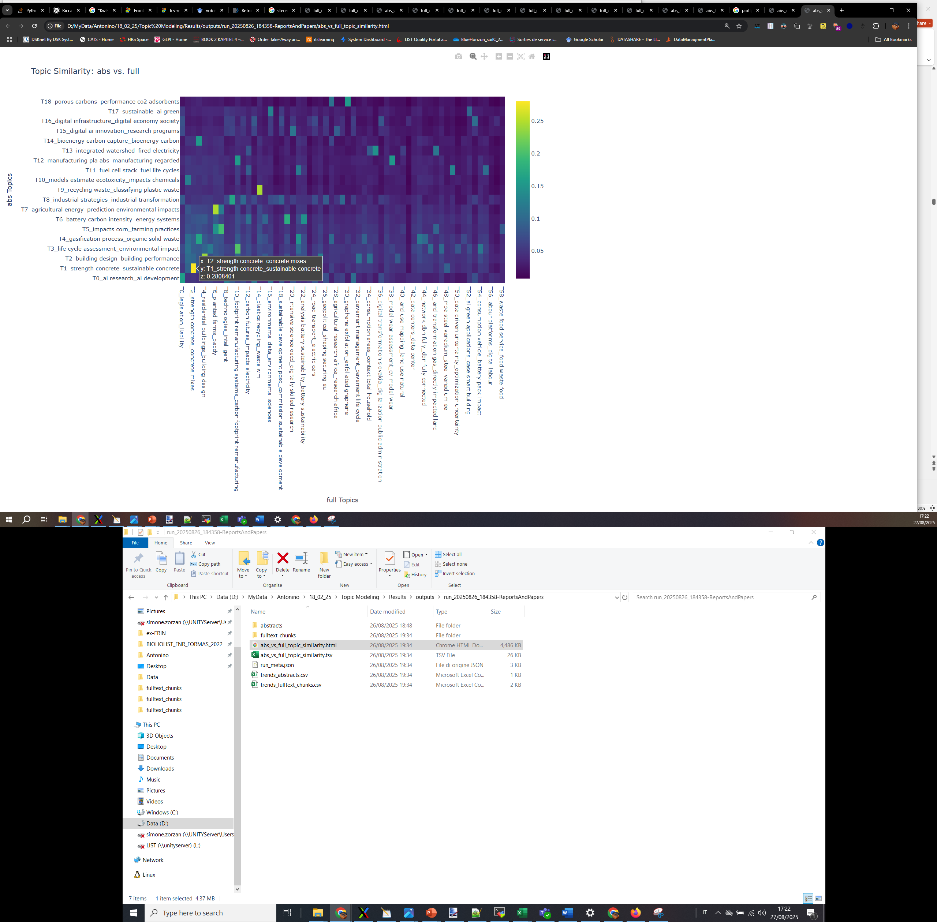
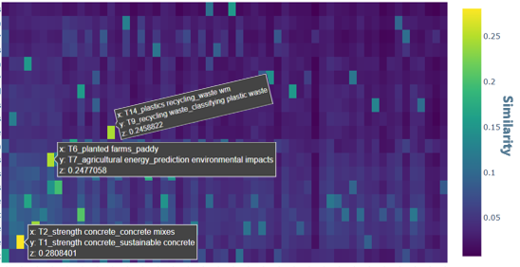
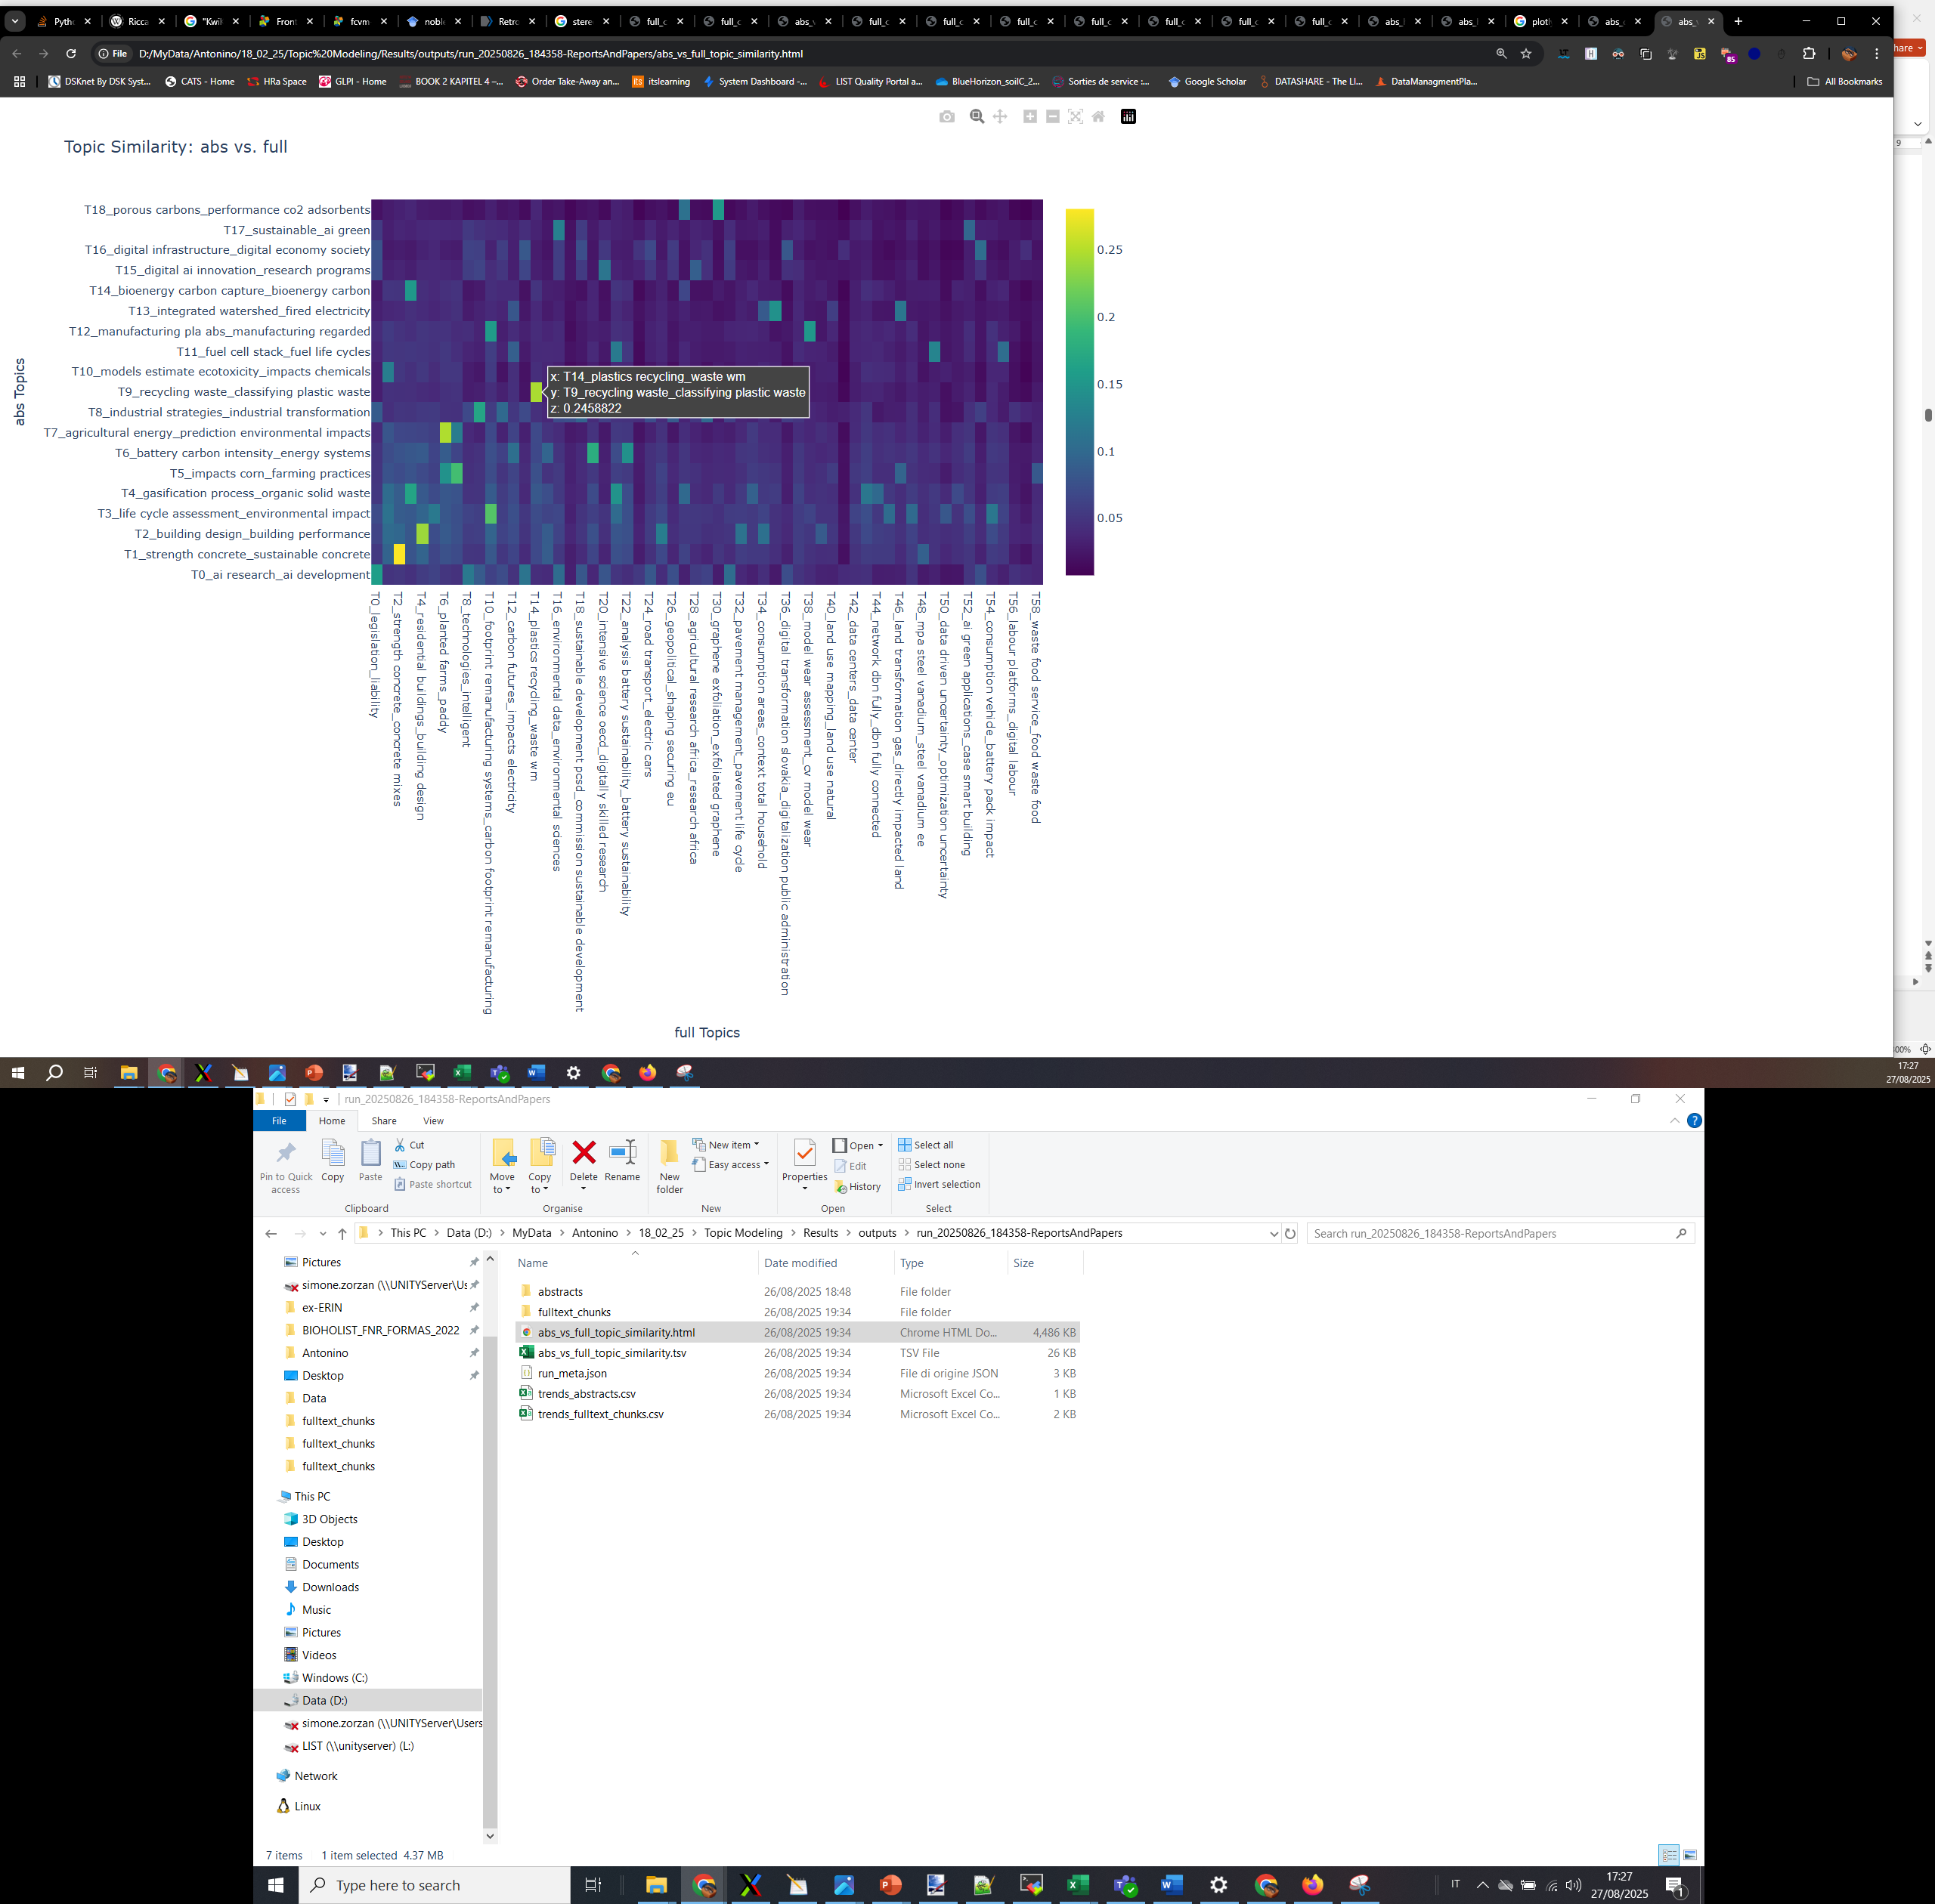

Topic similarity matrix (Abs vs Full text)
Topic similarity: Abstracts vs Full text
Analysing Reports and Papers as a unique corpus.
The two clustering identify similar global topics, but full text allows for more granularity and interpretability.
Similarity
(Abstract topcs)
(Full texts topics)

Slide 23
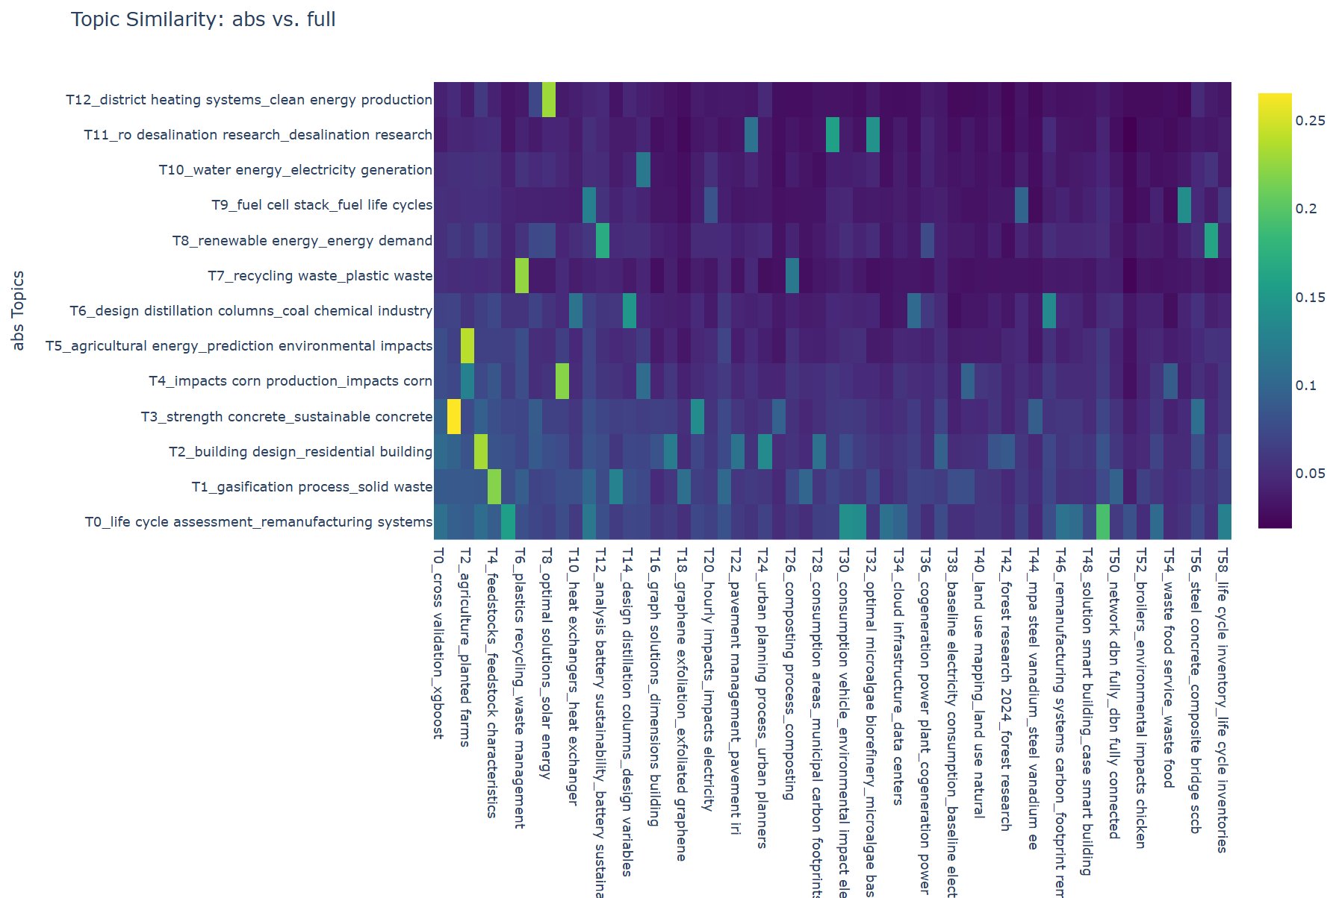


Topic similarity matrix (Abs vs Full text)
We decided to focus on Papers, because of the separation in the topic analysis.
The pipeline analysis was applied to the 154 papers selected by the AI screening.
(Abstracts)
(Full texts)

