Slide 1
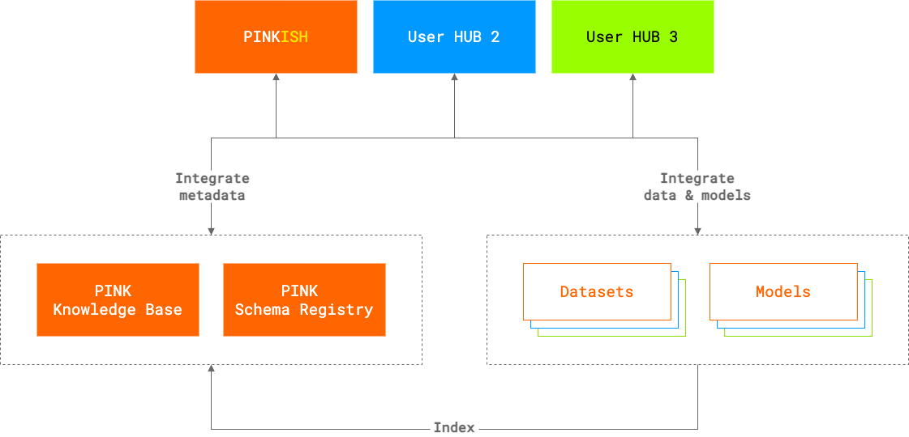
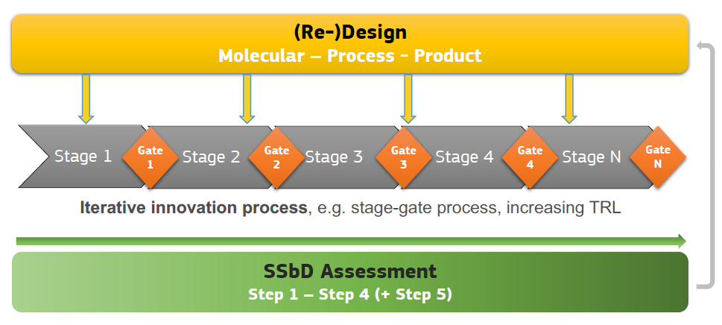
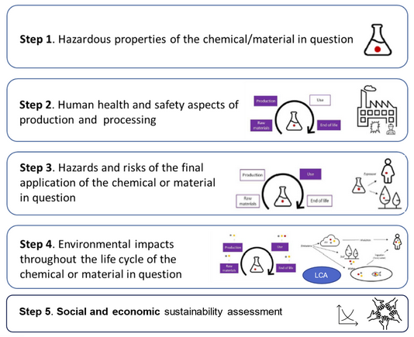
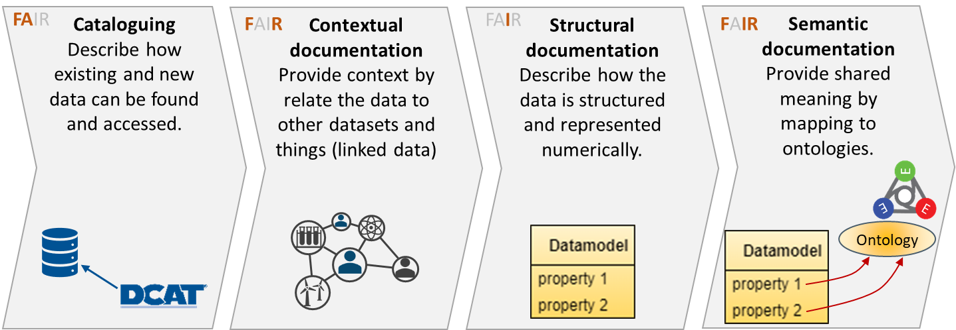
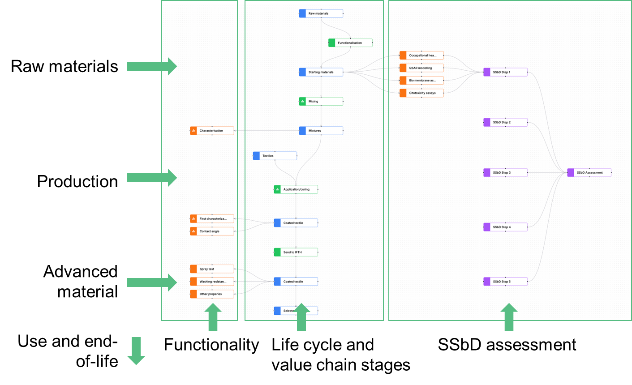











Interoperability FOR bridging
SSbD dimensions, value chains and material life cycle stages
Thomas Exnerª, Joahim Doklerª, Francesca Lonstad Bleken^{b}, Jesper Friis^{b}, Thomas Fjæstad Hagelien^{c}, Iseult Lynch^{d}, Georgios Gkoutos^{d}, Haralambos Sarimveis^{e}, Penny Nymark^{f}, Francesco Mercuri^{g}, Antreas Afantitis^{h} , Steffi Friedrichs^{i} and Martin Himly^{j}
ª Seven Past Nine, Cerknica, Slovenia; ^{b} SINTEF, Trondheim, Norway; ^{c} SINTEF Ocean, Trondheim, Norway; ^{d} University of Birmingham, United Kingdom; ^{e} National Technical University of Athens, Greece; ^{f} Karolinska Institutet, Stockholm, Sweden, ^{g} Consiglio Nazionale delle Ricerche, Bologna, Italy; ^{h} NovaMechnics, Nicosia, Cyprus; ^{i} AcumenIST, Brussels, Belgum, ^{j} Paris Lodron University Salzburg, Salzburg, Austria;
The SSbD Framework
The PINK Platform as a prototype of a federated open innovation environment
The European Union’s Green Deal and the proposed Clean Industrial Deal strive to make Europe the first climate-neutral continent by setting a path for transformation of its economy into a sustainable, climate-neutral and circular, competitive and resilient powerhouse that is just and socially fair. These goals are driving both environmental ("green") and technological ("digital") innovations, labelled as the twin green and digital transition. To achieve this transition, many innovation-driven markets including (but not limited to) healthcare, construction, new energies, transportation, electronics and agriculture, urgently require innovative materials as outlined in the Advanced Materials Initiative 2030 (AMI2030) roadmap [1].
The EU Joint Research Centre (JRC) was tasked to develop a framework to guide industry on how to improve safety and sustainability performance along the complete value chain and material life cycle [2]. This Safe-and-Sustainable-by-Design (SSbD) Framework follows a hierarchical approach consisting of two high-level components (the 1st level of the hierarchy), which are executed in an iterative manner: (i) the (re-) design phase, and (ii) the safety and sustainability assessment phase. The second is then further broken down into five key steps.
Data and models are seen as individual digital objects in PINK’s interoperability approach. These are accompanied by detailed documentation and semantic annotation for human understandability and increasingly computer-actionability. The documentation provides information to be indexed in the PINK Knowledge Base to support findability and accessibility (the first two letters in FAIR) as well as the relationships between resources thereby supporting interoperability (the I in FAIR). Additionally, standard data models will be stored in the PINK Schema Registry for inspection, e.g., to understand the structure of the data to enable automatic integration into workflows and decision support systems, and reuse (the R in FAIR), e.g., for structuring new datasets of the same or similar type. The PINK infrastructure components will then facilitate the integration of data, models and workflows based on these data models into user hubs. We define “hubs” as any user-facing service like databases, which provided additional functionality on top of the datasets, chemical dashboards, modelling software, decision support systems and any combination of these as anticipated for the PINK In Silico Hub (PINKISH).
[1] https://www.ami2030.eu/roadmap/
[2] https://doi.org/10.2760/487955.
Data and model documentation for semantic interoperability
PINK’s Objectives
DEVELOP innovative modelling and simulation approaches addressing industrial SSbD needs
MAKE the models accessible to SMEs and industry through an open innovation platform  PINK In Silico Hub - PINKISH
VALIDATE the open innovation platform on PINK Developmental Case Studies and Industrial Demonstrators provided by SMEs and large industries
REAL-LIFE industry needs:
  Assessment challenges in biodegradability of co-polymers in aqueous dispersions (long-term toxicity?)
  Long-term aquatic environmental effects of organic UV-blocker in cosmetics and personal care products
Fully IMPLEMENT open science and FAIR principles contributing to establishing a European chemicals and materials data, modelling and software ecosystem
STRENGTHEN knowledge transfer through collaboration and exploiting synergies
BOOST the innovative capacity of SMEs and industry and make them more agile to respond to external and internal influences
The four different levels of data documentation, applied stepwise, improve interoperability. “Data” is meant more generally here as research outputs including other information sources like protocols, SOPs and method descriptions as well as models, software and workflows. Levels 1 and 2 provide the information needed to create the PINK Knowledge Base as a knowledge graph connecting models with corresponding input and output resources. Levels 3 and 4 will then allow further automation of the computational workflows to evaluate SSbD criteria and collection of relevant data for the decision support system.
Study design maps
PINK’s holistic approach
Production
Use
Holistic view on material
value chain and life cycle
Raw Materials +
Extraction
Logistic +
Commerce
End of life +
Recycling
Translation
Tiered list of indicators
representing the SSbD dimensions
Function and process design
Safety
Sustainability
Circularity
Study design maps are used to plan the material development campaign, visualise processes and material life cycle stages along the value chain, define data needs across all SSbD dimensions and assign responsibilities for their collections, and finally to link data and the SSbD evaluation results. Combined with the data documentation, they provide access to all information used for decision making in the “by-design” approach.
PINK integrates data and computational models for all these indicators, provided by PINK partners or third parties. Both data-driven and physics-based modelling and simulations are applied across materials modelling, computational toxicology, life cycle assessment and costing, and Adverse Outcome Pathway-based reasoning.

