Slide 1
Project Overview
OBJECTIVES, PLANNED IMPLEMENTATION AND EXPECTED IMPACT
PARC TASK 8.1.3 Meeting,
16 April 2025

Slide 2
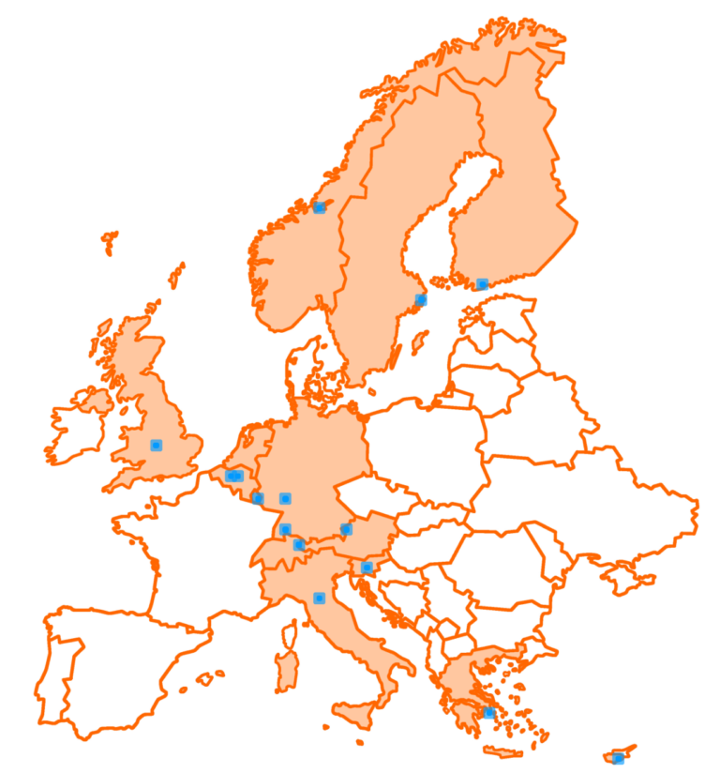
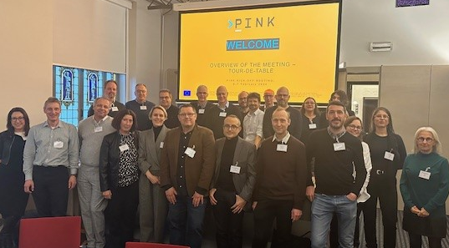
The PINK team
12 Beneficiaries - 2 Affiliated Entities - 2 Associated Partners
Jan 2024 - Dec 2027

Slide 3
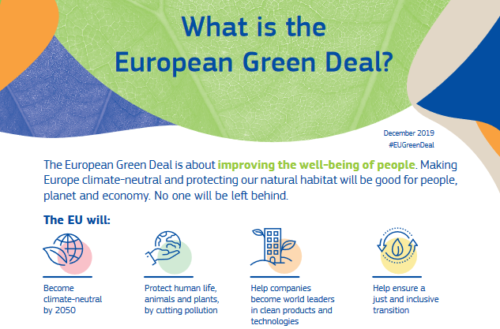
PINK’s ambition to contribute to…
3

Slide 4
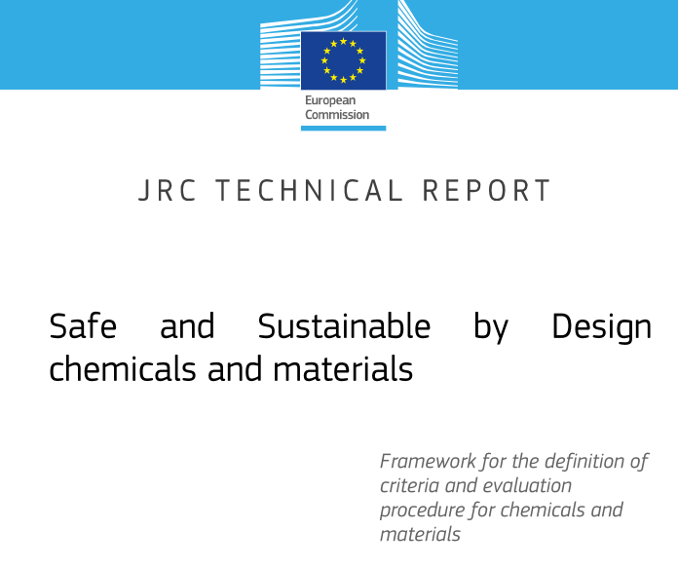
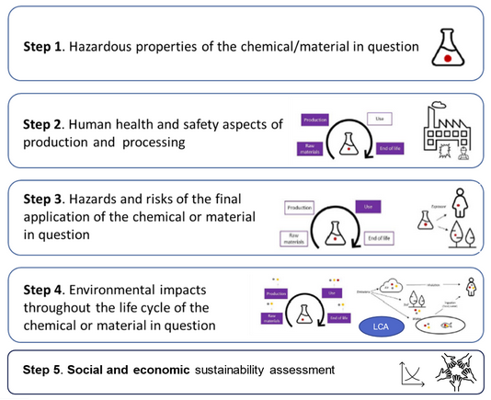
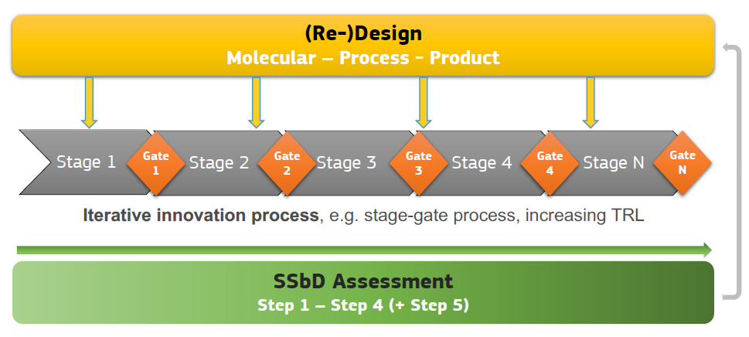
... by implementing industry-ready SSbD

Slide 5


Where to implement SSbD
System
Eliminate / substitute
Change
Use/need for function
Process
Product
Material
Drop-in replacement
Substance of concern (SoC)
Re-design
Larrea Gallegos G.M., et al., CSBJ:NAM (submitted)

Slide 6
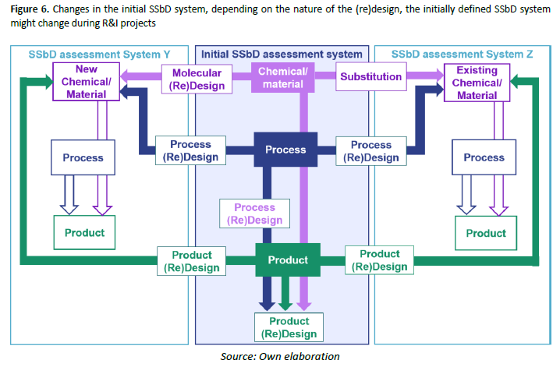
Where to implement SSbD
European Commission, Joint Research Centre, Abbate, E., Garmendia Aguirre, I., Bracalente, G.,
Mancini, L., Tosches, D., Rasmussen, K., Bennett, M.J., Rauscher, H. and Sala, S., Safe and Sustainable by Design chemicals
and materials - Methodological Guidance, Publications Office of the European Union, Luxembourg, 2024, https://data.europa.
eu/doi/10.2760/28450, JRC138035

Slide 7
PINK’s high-level objectives
DEVELOP innovative modelling and simulation approaches addressing industrial SSbD needs
MAKE the software accessible to SMEs and industry through the open innovation platform  PINK In Silico Hub - PINKISH
VALIDATE the platform on PINK Developmental Case Studies and Industrial Demonstrators provided by SMEs and large industries
REAL-LIFE industry needs:
  Assessment challenges in biodegradability of co-polymers in aqueous dispersions (long-term toxicity?)
  Long-term aquatic environmental effects of organic UV-blocker in cosmetics and personal care products
Fully IMPLEMENT open science and FAIR principles contributing to establishing a European chemicals and materials data, modelling and software ecosystem
STRENGTHEN knowledge transfer through collaboration and exploiting synergies
BOOST the innovative capacity of SMEs and industry and make them more agile to respond to external and internal influences

Slide 8











PINK’s holistic approach
Production
Use
Holistic view on material
value chain and life cycle
Raw Materials +
Extraction
Logistic +
Commerce
End of life +
Recycling
Translation
Tiered list of indicators
representing the SSbD dimensions
Function and process design
Safety
Circularity
Sustainability

Slide 9
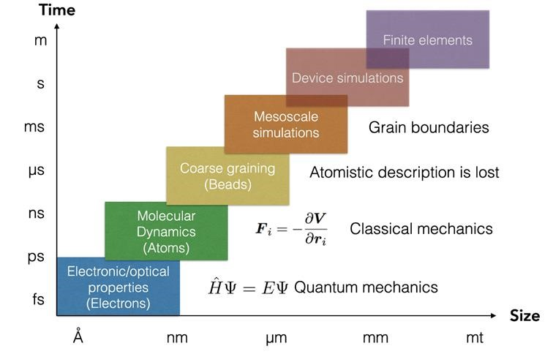
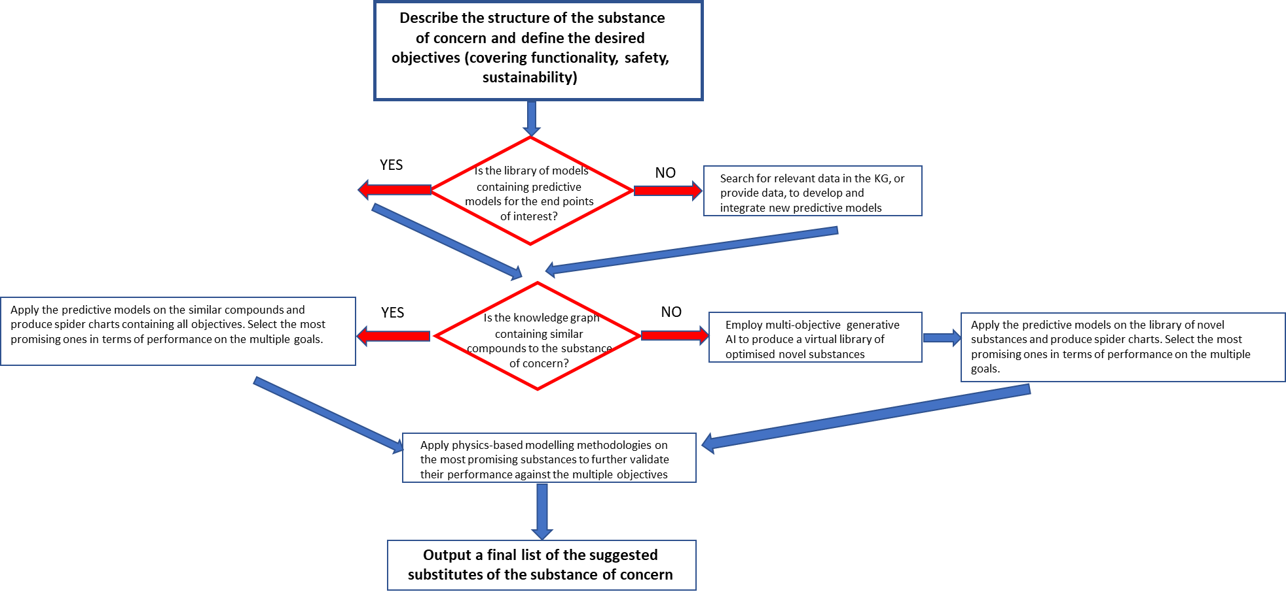
PINK’s innovative modelling
Physics-based multi-scale modelling
Data-driven approaches
  QSA/PR models
  Read-across
  Mechanistic models for biokinetics simulations
  Safe and sustainable production
  Life-cycle assessment including exploratory/prospective LCA
  AOP-driven evidence generation
Decision support and user guidance
→ PINKISH
  Integrated Knowledge Graph
  Generative AI with property constraint
  Causal (AI) modelling

Slide 10
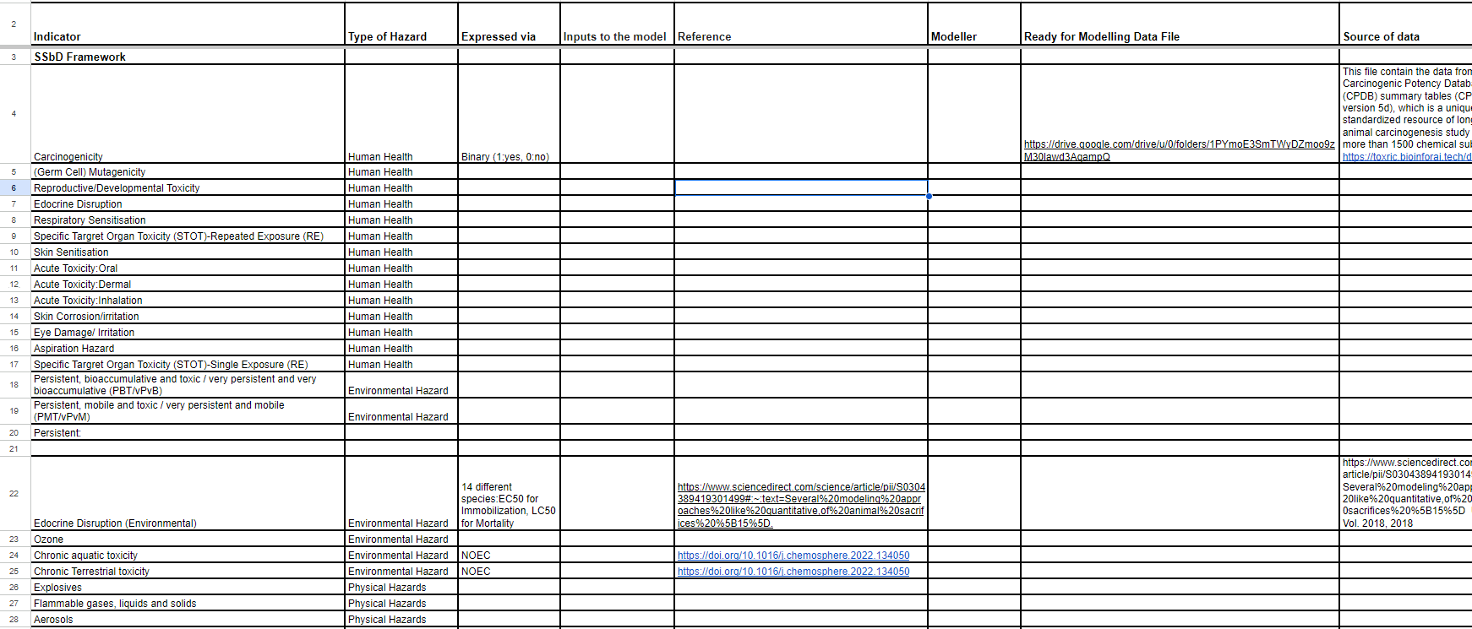
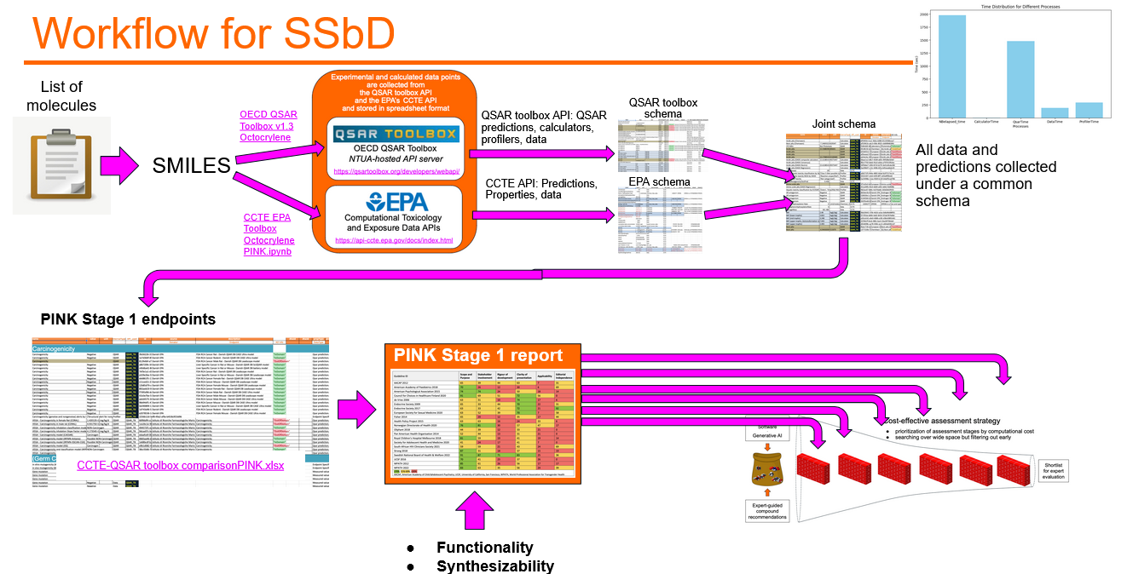
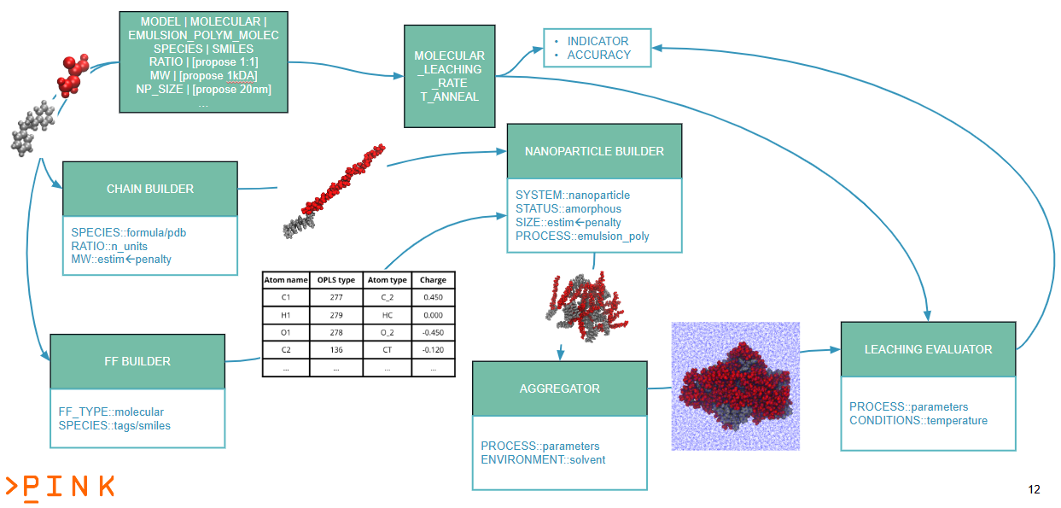
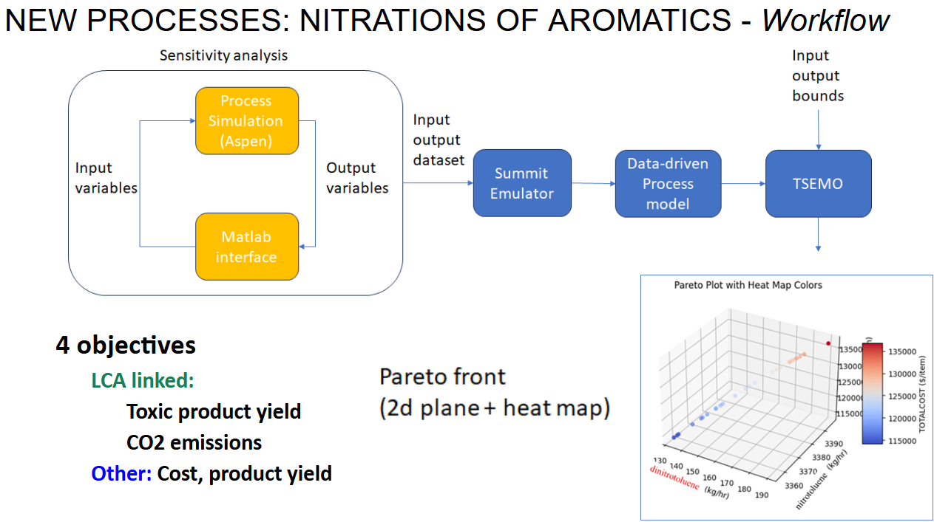
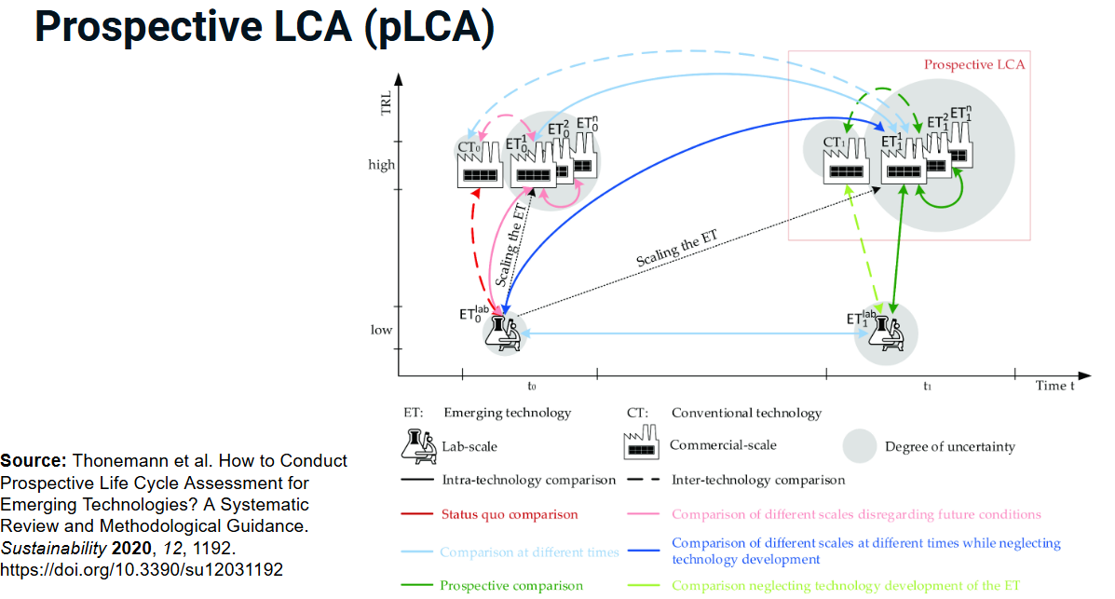
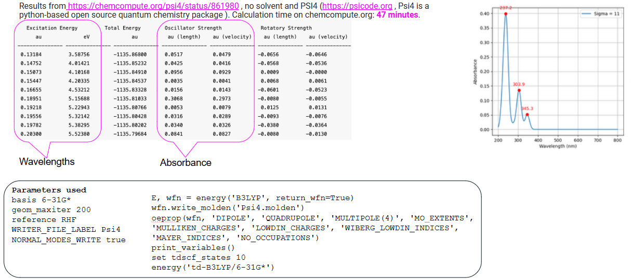
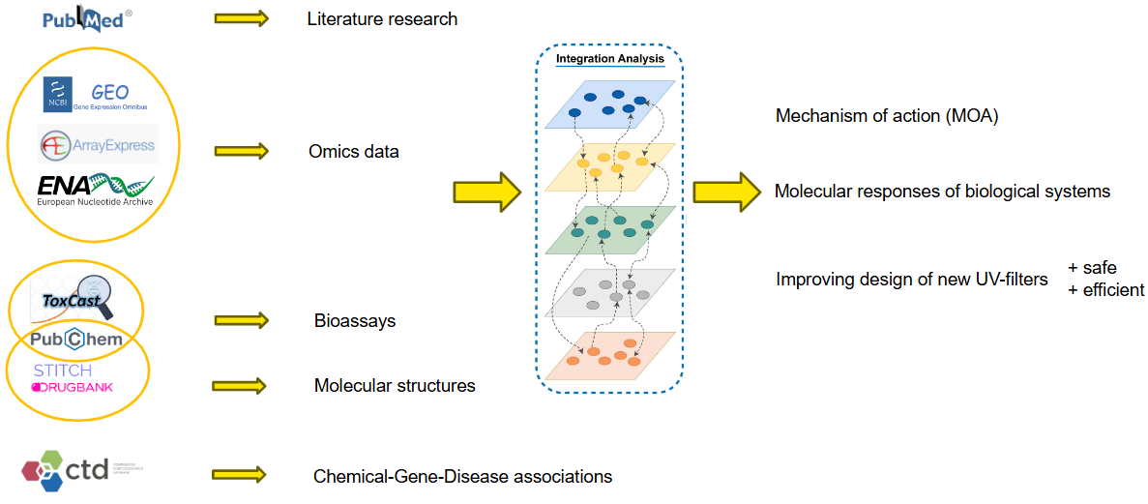
Tools for all SSbD dimensions

Slide 11
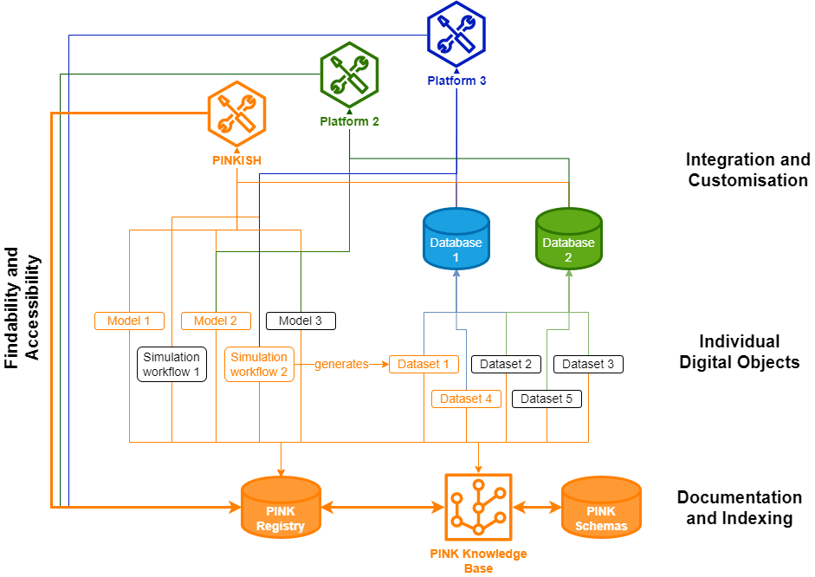
Working towards an interoperable ecosystem
PINKISH

Slide 12
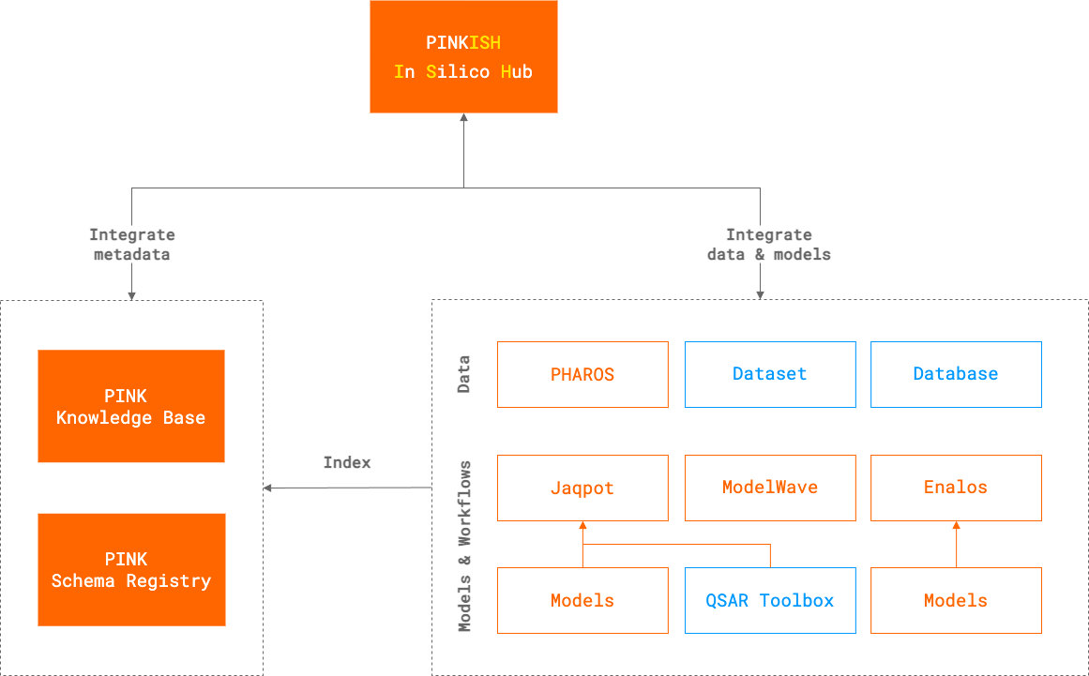
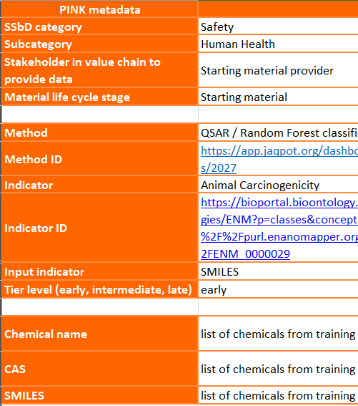
Working towards an interoperable ecosystem
PINKISH

Slide 13

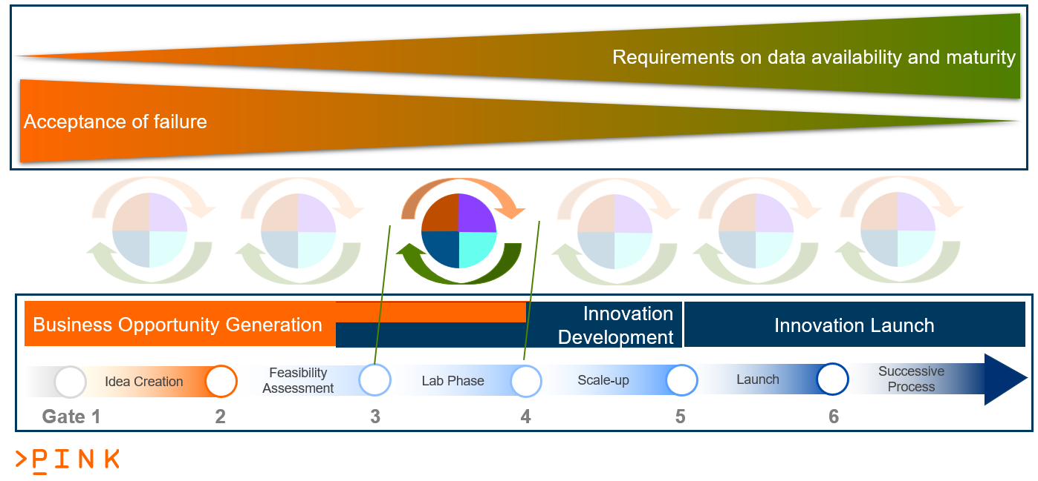
PINK’s tiered approach

Slide 14
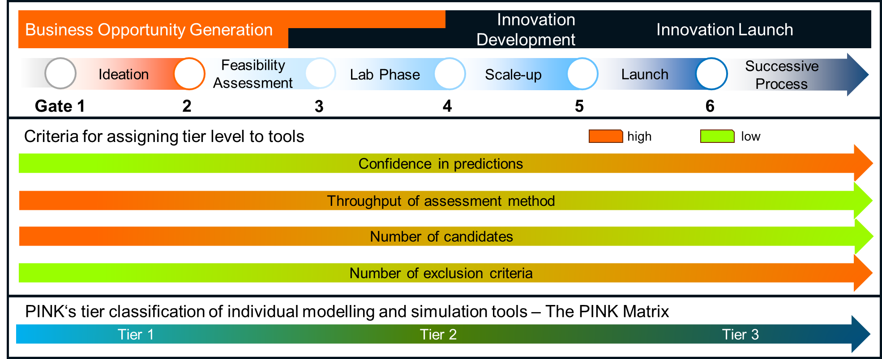
PINK’s tiered approach

Slide 15
PINK’s tiered approach
Cross-scenario enabling aspects
  Innovation
  Development
Innovation Launch
Business Opportunity Generation
Ideation
Feasibility
Assessment
Lab Phase
Scale-up
Launch
Successive Process
Gate 1
2
3
4
5
6
Scenario 2
Scenario 1
Scenario 3
Integration of experimental safe and sustainable data
Integration of process data
Full virtual chemical / materials space
Minimal set of predicted properties as exclusion criteria
Targeting complete coverage of regulatory criteria
Material group specific selection of relevant characteristics in all SSbD dimensions
Cross-scenario enabling aspects
Technical and sematic interoperability
Classification of individual tools into tiers according to criteria above related but not fixed to the scenarios or gates
Options to transfer information along the value chain from raw material providers to product production to end-of-life / recycling
Decision support when to introduce individual aspects (all dimensions) according to the specific case

Slide 16
PINK’s industry focus
Jan 2024
June 2025
Dec 2026
Dec 2027
1. REFINE and 3. INTEGRATE
Requirement analysis, PINK Platform specification and Developmental Case Study definition
4. VALIDATE and 5. REAL-WORLD
Developmental Case Study execution
driving PINK Platform development
7. STRENGHTEN and 8. BOOST
Onboarding and execution of Industrial Demonstrators
Developmental Case Study 1: styrene/acrylate copolymers
→ low biodegradation
Developmental Case Study 2: organic UVB-filter
→ has to be classified for chronic aquatic effects
Industrial Demonstrators → to be defined
Survey
Early adopters
Execution phase
Industry workshop
Planning phase:
one-to-one meetings
Amendment

Slide 17
2 Developmental Case Studies – 3 Scenarios
Scenario 1 - Business opportunity stage (Tier 1)
→ through inter-/extrapolation multiple candidates generated in silico; potential sustainability constraints determined by predictive modelling in parallel to functional performance testing/modelling;
Scenario 2 - Innovation development stage (Tier 2)
→ defined by one lead structure identified; some information is available (performance and partially safety and sustainability) with in silico tool-based modifications going on and sustainability criteria being evaluated;
Scenario 3 - Material & innovation launch stages (Tier 3)
→ more data for several dimensions becomes available

Slide 18
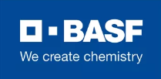
Developmental Case Studies
Organic synthetic UVB-filter used in sunscreens
  data-rich
  concentrations up to 10 wt% in cosmetic products
  environmental behaviour re-assessed
  low human health hazard
  chronic aquatic effects
Styrene/acrylate co-polymers used in aqueous polymer dispersions
  particles diameter 10 – 1500 nm
  important raw materials for industrial processes (Mt dispersions used)
  adhesives, paints, coatings, paper board coating, nonwoven fabrics, carpets, construction materials, textile finishing agents
  low human health and environmental hazard
  low biodegradation

Slide 19
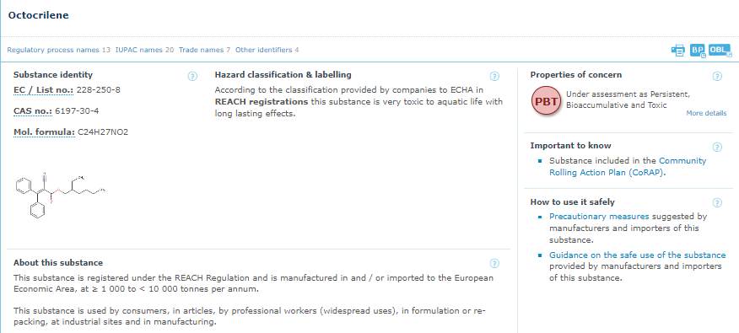
Case Study 1
Organic synthetic UV-filter used in sunscreens
Source: ECHA substance information
Notes:
An organic UVB-filter used in sunscreen application. The data-rich substance was re-evaluated by the EU SCCS in 2021 and assessed as safe as a UV-filter at concentrations up to 10 wt% in cosmetic products. It is also under evaluation in the Community rolling action plan (CoRAP) process, which has a broad scope including environmental effects and environmental behaviour. Based on the most recent assessment the UVB filter has a low human health hazard but has to be classified for chronic aquatic effects.

Slide 20
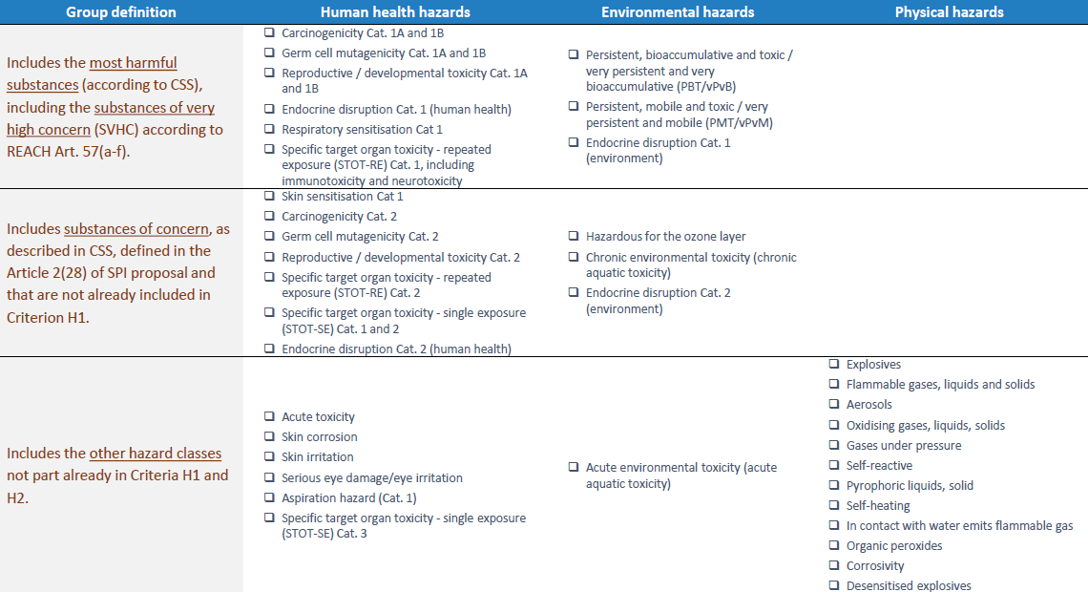
H1
Drop-in replacement of SVHC, SHC, SoC
H2
H3

Slide 21

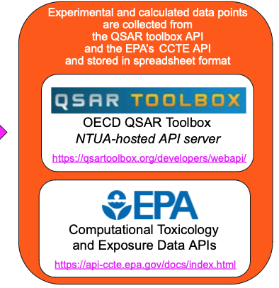

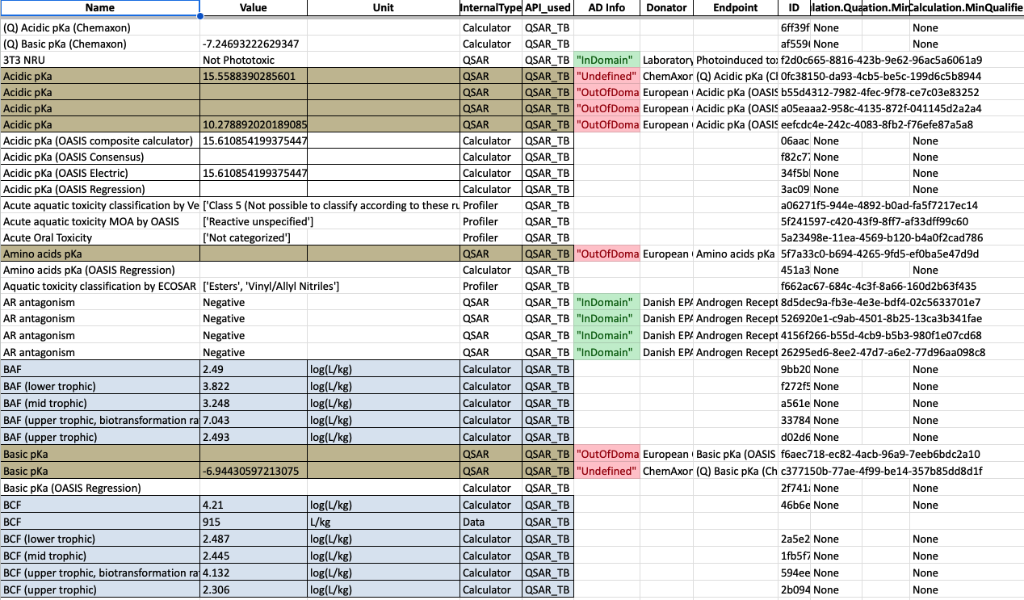

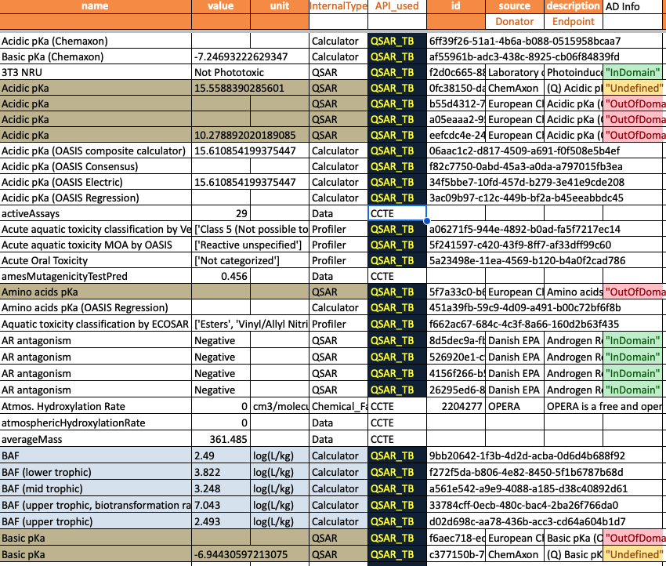
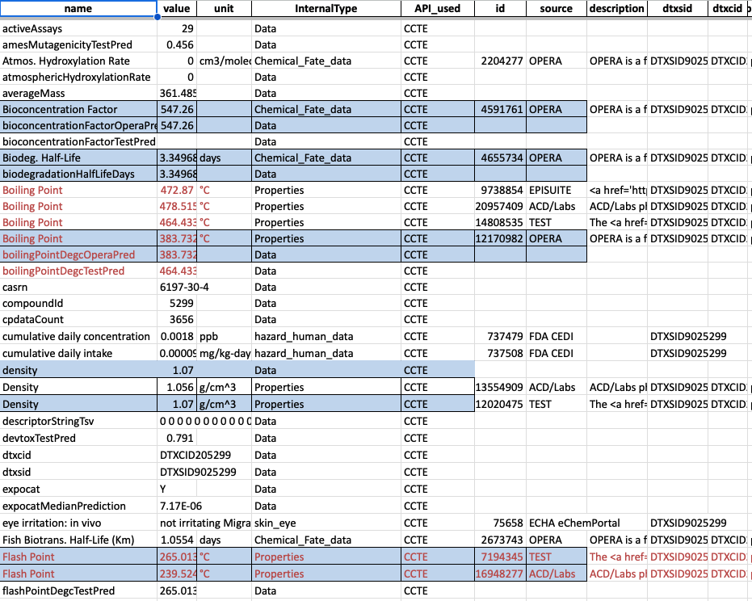
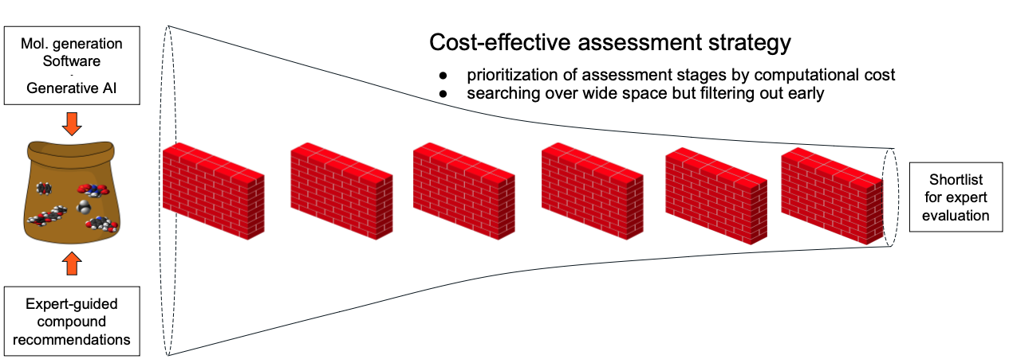
Workflow for SSbD
List of molecules
QSAR toolbox schema
QSAR toolbox API: QSAR predictions, calculators, profilers, data
Joint schema
QSAR Toolbox v1.7 Uniform_Output Stage1
All data and predictions collected under a common schema
SMILES
CCTE API: Predictions, Properties, data
CCTE EPA Toolbox Octocrylene PINK.ipynb
EPA schema
Selection of
PINK Stage 1 endpoints
PINK_Stage1_Assessment Report.xlsx
PINK Stage 1 report
Report generation PINK Stage1 v3 ToolBox+EPA.ipynb
Functionality
Synthesizability

Slide 22
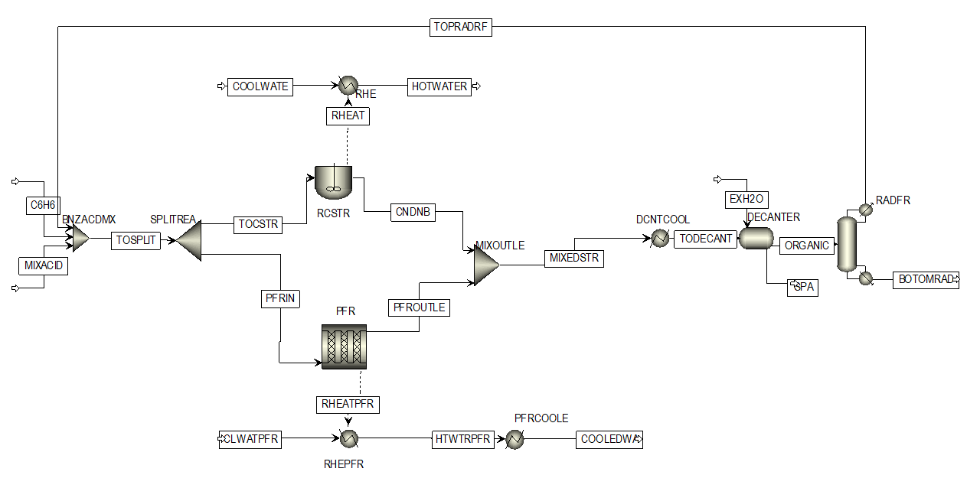
Process optimisation
Example process: nitration of benzene Design options for reactor: PFR or CSTR
or
or
Binary variable {0, 1}:
0 for PFR,
1 for CSTR
Translated into
categorical variable
“PFR” and “CSTR”
Same objectives:
max Nirobenzene yield
min Dinitrobenzene yield (toxic)
min CO2 emissions
min Total cost

Slide 23
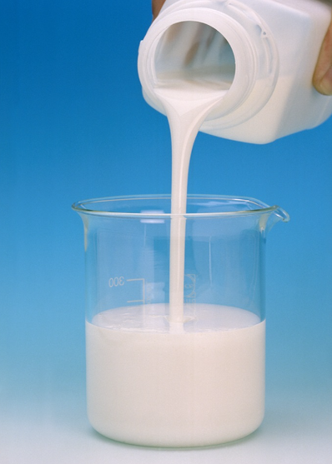
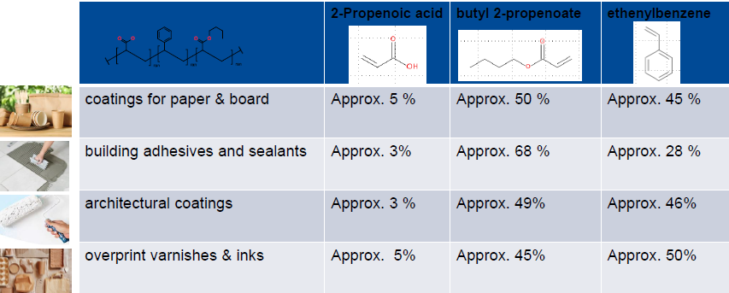
Case Study 2
Styrene/acrylate copolymers used in aqueous polymer dispersions
Styrene/acrylate copolymers are structurally similar polymers that result from the polymerisation of acrylate, methacrylate and styrene monomers.
Acrylate polymers biodegrade slowly under environmental conditions
Generic examples:
Notes:
Developmental Case Study 1: Styrene/acrylate copolymers used in aqueous polymer dispersions (particles diameter 10 – 1500 nm). Those acrylic copolymers are important raw materials used in industrial processes. Millions of tons of polymer dispersions are used as binders in applications such as adhesives, paints, coatings, paper and paper board coating, nonwoven fabrics, carpets, construction materials, and textile finishing agents (Galloway et al., 2017, Ma-Hock et al., 2012). The styrene/acrylate polymer shows a low human health and environmental hazard and based on the use profile a low biodegradation.

Slide 24
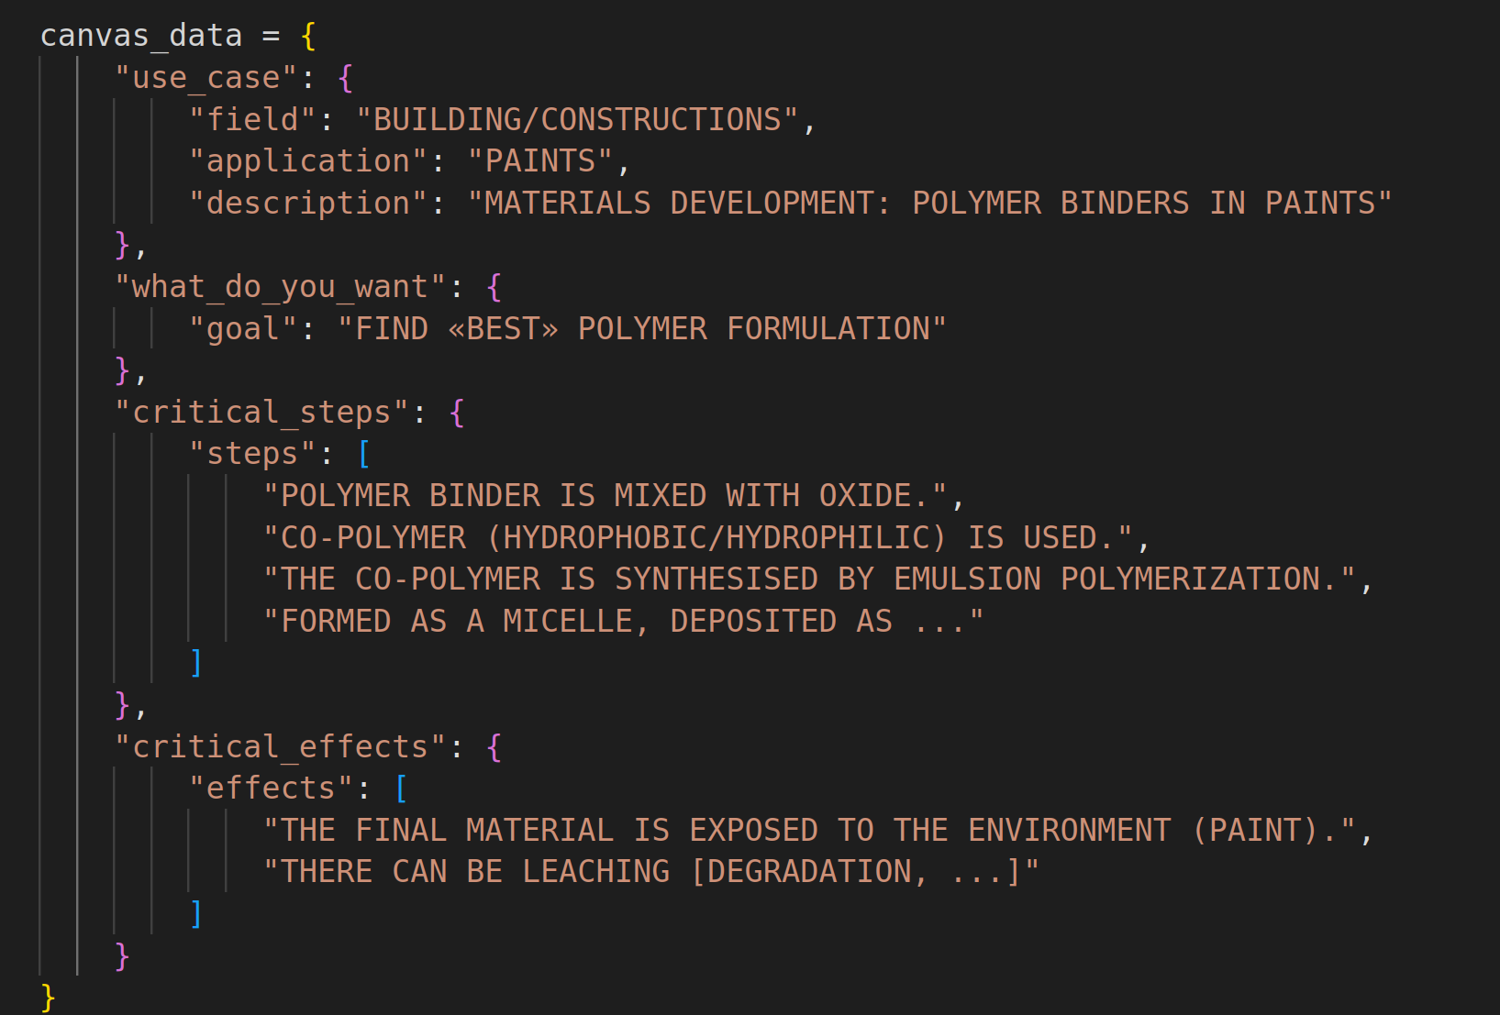
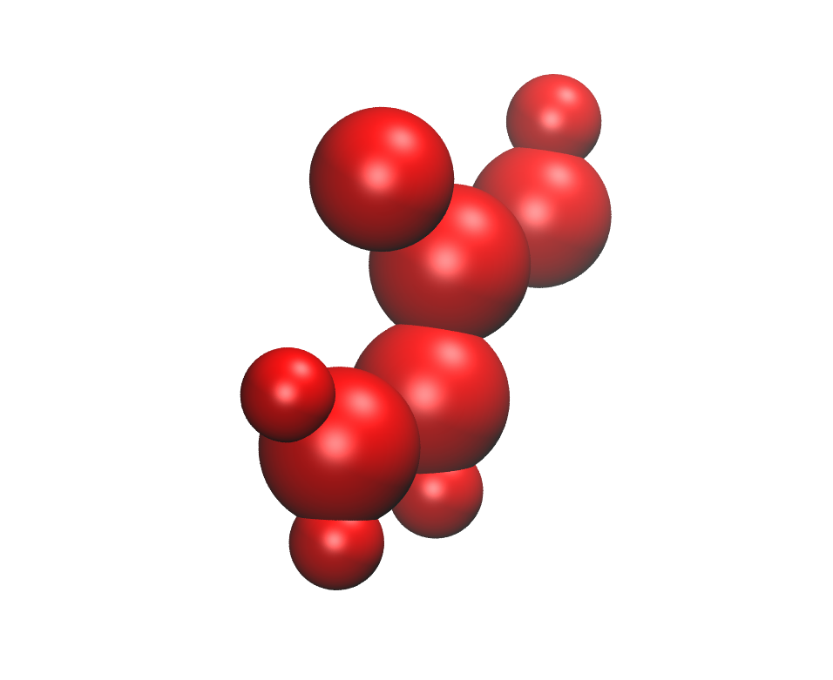
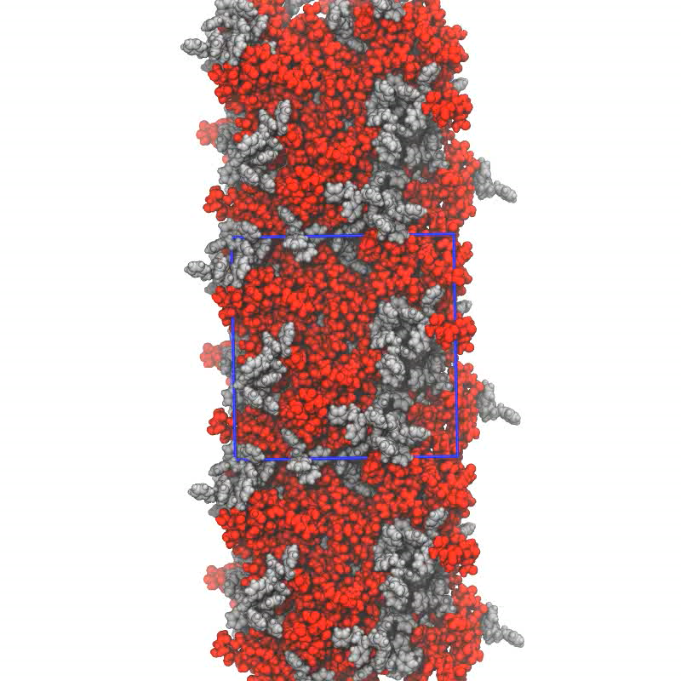
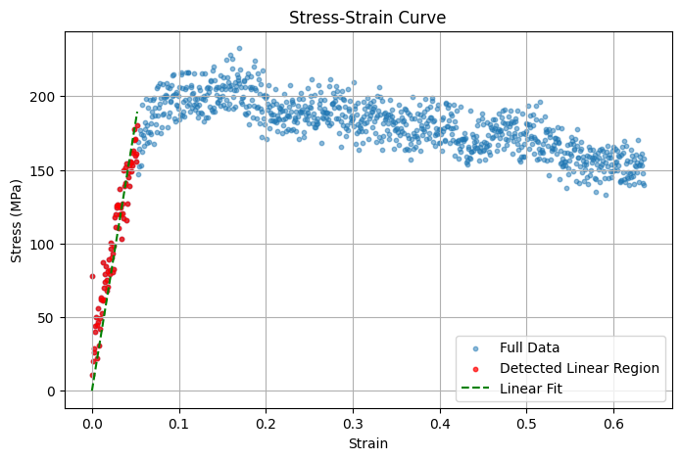
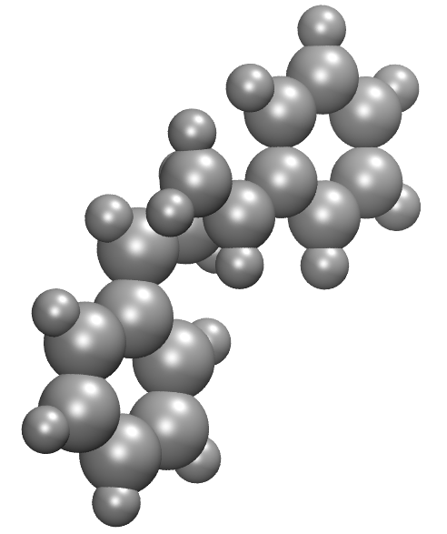
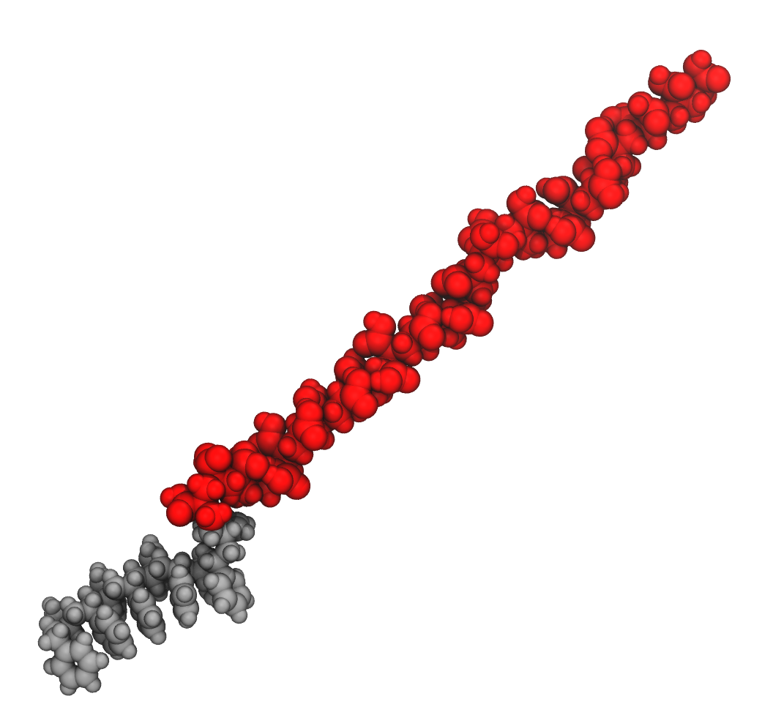
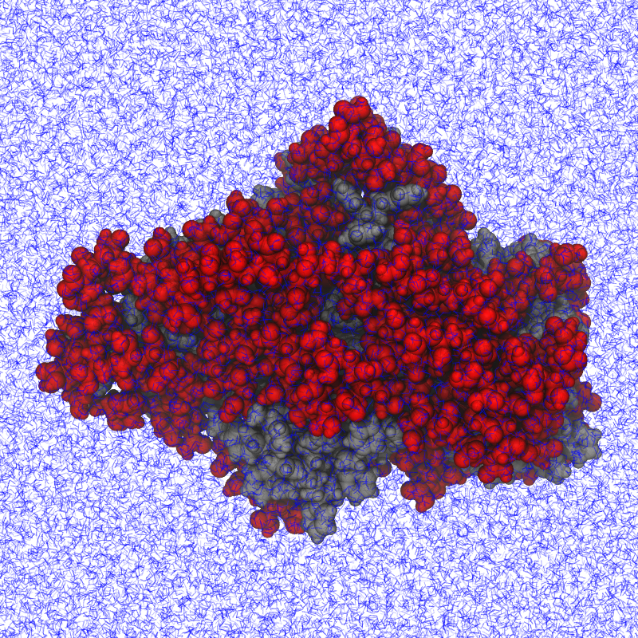
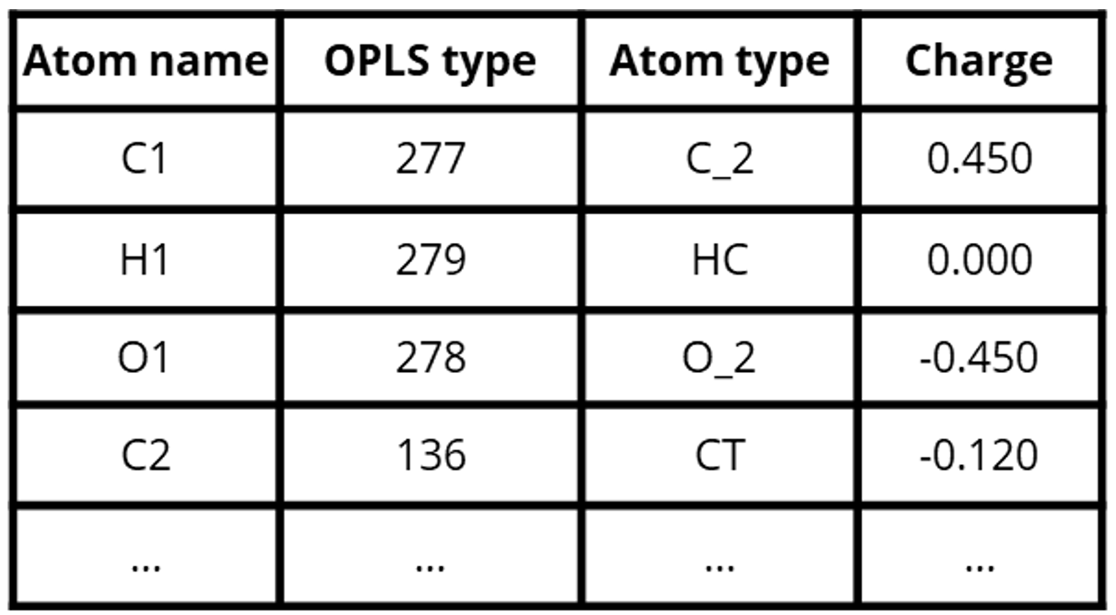
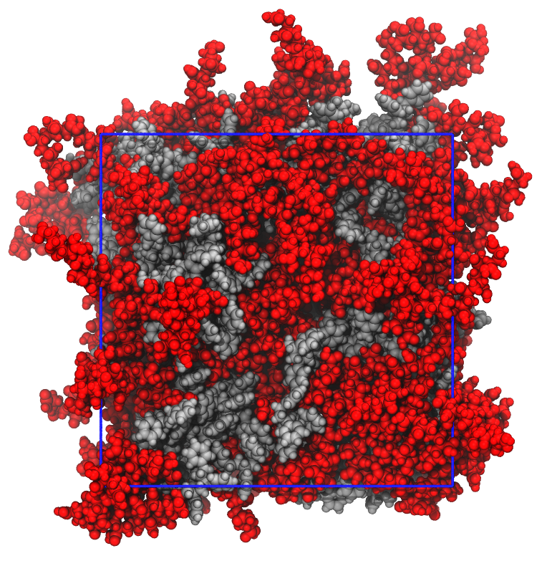
Workflow development – PS-PAA degradation
MODEL | MOLECULAR | EMULSION_POLYM_MOLEC
SPECIES | SMILES
RATIO | [propose 1:1]
MW | [propose 1kDA]
NP_SIZE | [propose 20nm]
…
INDICATORS
ACCURACY
AGGREGATOR
CHAIN BUILDER
HYDROLITIC
DEGRADATION
SYSTEM::co-polymer
STATUS::amorphous
SIZE::n. chains
ENVIRONMENT::solvent
SPECIES::formula/pdb
RATIO::n_units
PROCESS::parameters
CONDITIONS::temperature
  Young’s Modulus
  Yield Strength
  Fracture Strain
FF BUILDER
MECHANICAL DEGRADATION
FF_TYPE::molecular
SPECIES::tags/smiles
PROCESS::parameters
ENVIRONMENT::solvent
  MD stress simulation

Slide 25
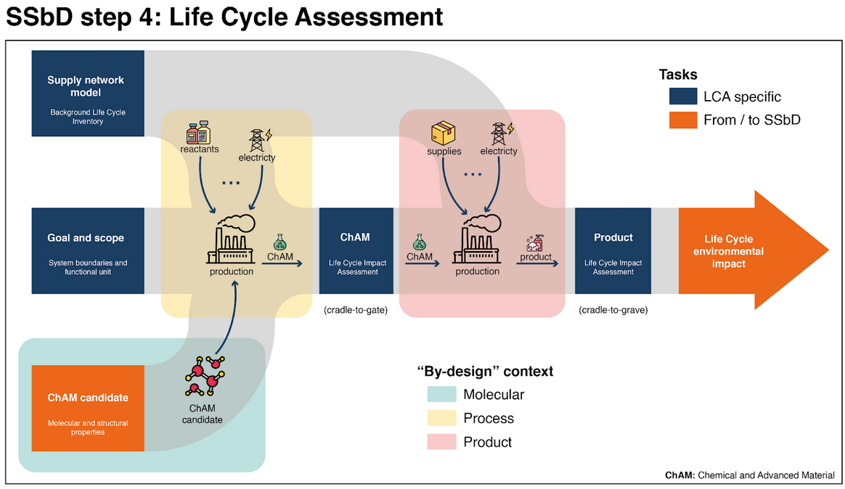
Tiered LCA

Slide 26
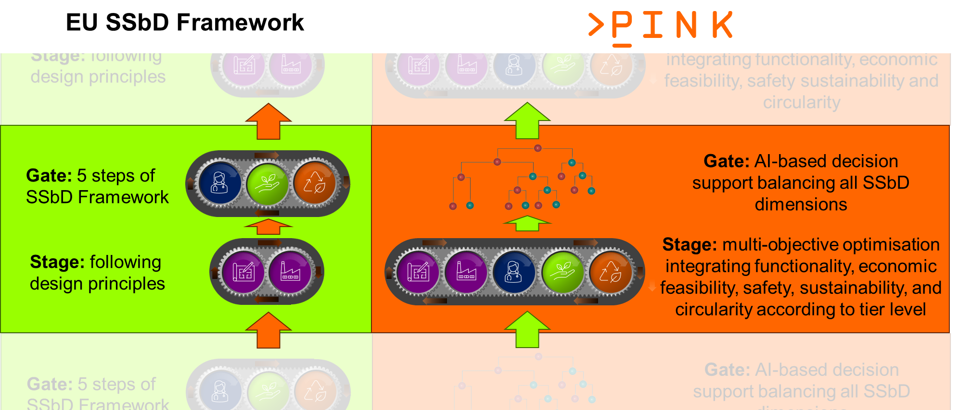
Multi-objective optimization for (re-)design

Slide 27
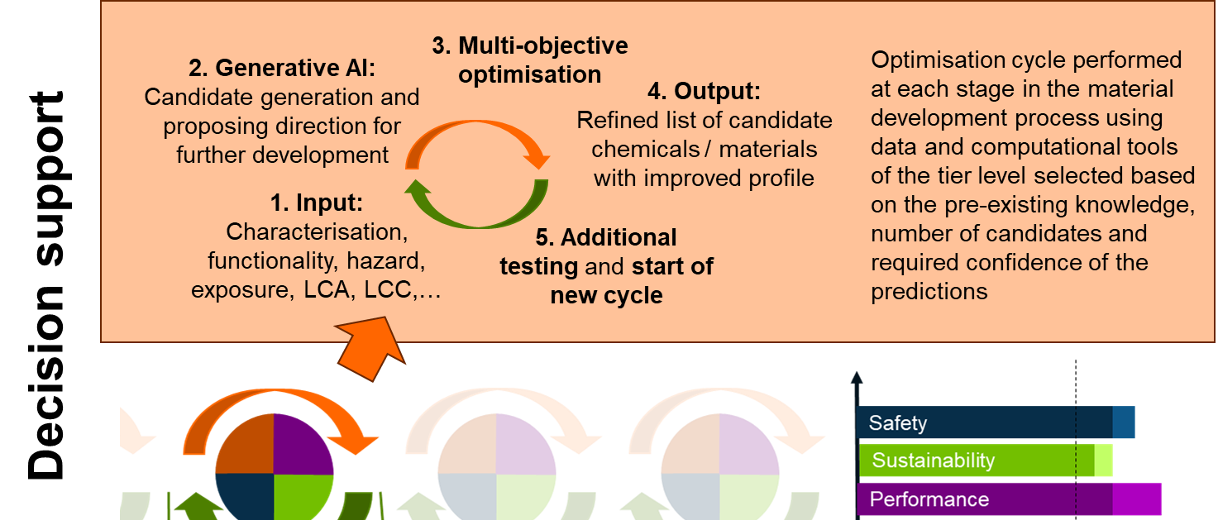
Decision support for (re-)design

Slide 28
PINK in two words
INTEGRATE
Economic
efficiency
Functionality
+ BALANCE
Safety
Environmental
sustainability
Social
sustainability

Slide 29
>THANK YOU!
1 Thomas Exner
2 Seven Past Nine▌
_
WWW.PINK-PROJECT.EU

